Slide 1


www.erasmus-artist.eu

Slide 2
This project has been funded with support from the European Commission.
This publication [communication] reflects the views only of the authors,
and the Commission cannot be held responsible for any use which may be
made of the information contained therein.

Slide 3


TY Science:
Producing novel science modules with student teachers – action research for PSSTs
^{UL ARTIST Team}
^{ARTIST, Batumi Workshop 2019}

Slide 4
Background
This workshop describes an action research project running from 2003-2016 with final year pre-service science teachers (PSSTs) at the University of Limerick.
The students developed novel teaching materials for use on their teaching practice and also involved other students and teachers.
They were specifically aimed at the Irish transition year (TY).

Slide 5
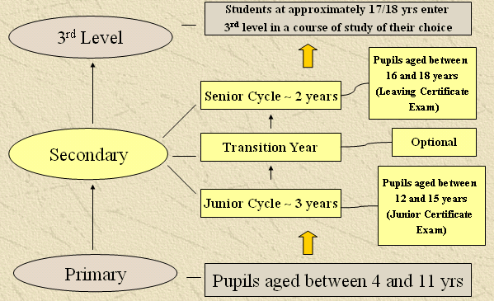
The Irish Education System

Slide 6
TYO: An opportunity for curriculum development
The only place in the system with freedom to innovate is the Transition Year Option, between junior and senior cycle.
TYO is optional – depends on the school and on the students.
TYO is broadly specified, it is not examined, and teachers have freedom to devise or choose their own science curriculum.

Slide 7
TY Science project at UL
The TY Science project aims to provide teachers with interesting, context-based materials for TYO.
The overall aim is to make science more interesting, in order to encourage more students to take LC science subjects.
It involves final year trainee science teachers developing teaching modules as a Final Year Project.

Slide 8
Guiding principles in the modules
The TY Science modules were designed to:
Build on the previous Junior Science course,
Develop practical and laboratory skills,
Develop the scientific method and related skills, e.g. inquiry
Develop IT and communication skills,
Involve hands-on activities and active learning,
Be related to everyday contexts with an STS focus,
Develop scientific literacy,
Be interdisciplinary involving aspects of Biology, Chemistry and Physics.

Slide 9
Action Research in Practice
The TY Science project is an example of action research involving PSSTs and science teachers and science researchers. The project involkves the design, development, implementation, evaluation and revision of novel curriculum materials relating to a specific school/student/social/curriculum context.

Slide 10
Structure of the modules
Designed to cover 8 week’s work.
Module consists of a series of 8 units.
Each unit consists of 1 double lesson, 1 single lesson and an optional extension single lesson.
Each unit is related to the overall theme but can be taught independently.
Emphasis on active and inquiry learning and practical work.
Development of ICT and communication skills.
Provided as a photocopiable Student’s Guide and Teacher’s Guide.

Slide 11
The development of modules
Choose theme
Select topics
Design teaching materials
Identify teachers and schools
Implement module
Evaluate module
Revise module
Disseminate materials
Get feedback on wider use

Slide 12
Module themes
Completed and available to teachers (date of publication) and author
Forensic Science (2004) Sindy Meleady
Cosmetic Science (2004) Audrey O’Grady
The Science of Sport (2004) Maria Sheehan
Science of Survival (2007) Rebecca Moran
Environmental Science (2007) Sarah Hayes
Issues in Science (2009) Ciara Hayes
Science and Medicine (2009) Karen Murphy
Food Science (2009) Anne O’Dwyer
Under revision
Space Science & Technology (2009) Walter Mahony
Science of Cleaning (2010) Maeve Liston
Waste not, want not (2010) Hannah McDonnell
Power for the future (2010) Nicholas Ryan
Science of Toys (2011) Joannah Kennedy
Smart Materials (2011) Martin Sheehan

Slide 13
Success of the project
Results from Sarah Hayes’ TY Science study showed that:
100% of teachers find the teacher’s guide helpful
Over 90% of teachers who responded felt that the students enjoyed using the modules and found them easy to use.
Teachers noted that the modules met their needs because they
“help introduce life skills”
“have a good mix of student active work and practical's”
“the resources needed for practical work are cheap and easy to get”
“students are interested and want to complete the modules”

Slide 14
TY Science modules
Four examples:
Science and Sport (Maria Sheehan)
Food Science (Anne O’Dwyer)
Science and Medicine (Karen Murphy)
Homemade Heroes (Laurie Ryan)

Slide 15
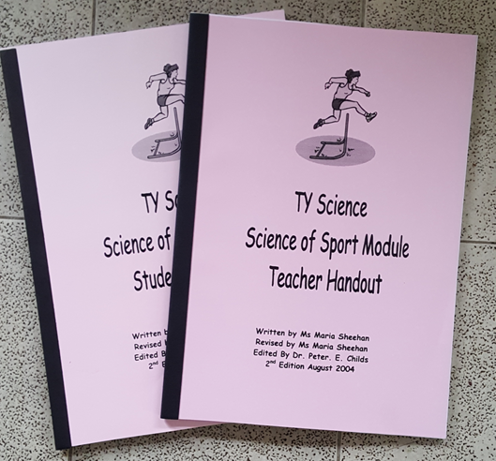
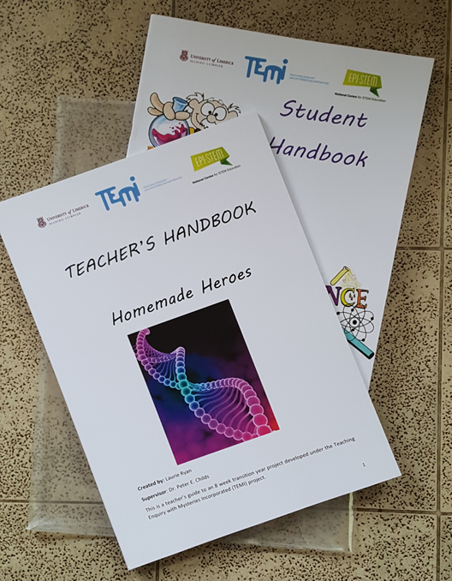
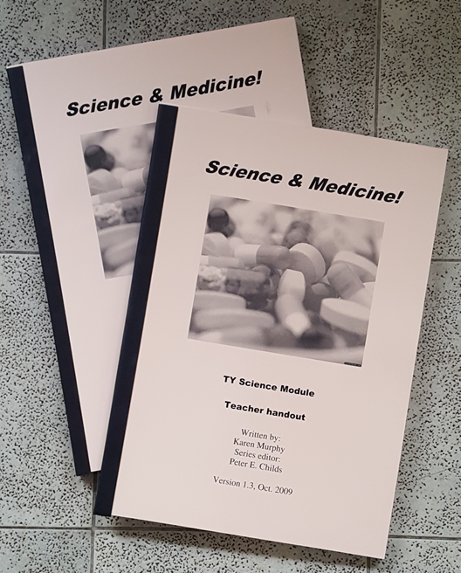

Slide 16
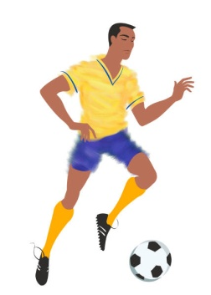
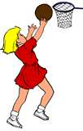
Science of Sport (Maria Sheehan)
The aim of this project is to utilize sport as a vehicle in developing a teaching package, which will see students applying science to their everyday lives, as well as enabling teachers to employ a wide variety of teaching methods and approaches.

Slide 17
Outline of the module
The Science of Sport module contains nine units:
1. Energy for Exercise
2. Food as fuel
3. Chemistry and sport success
4. Science of training
5. The lungs and exercise
6. The heart and exercise
7. The bones of sport
8. The physics of sport
9. A sporting profile

Slide 18
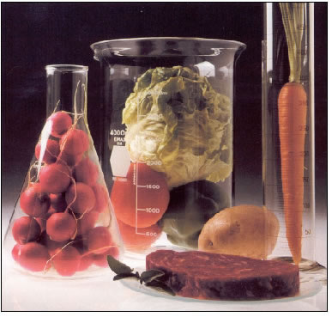
Food Science (Anne O’Dwyer)

Slide 19
Structure of the Food Science Module
Units | Lessons
1: A taste for more | Lesson 1- Looking into Food Lesson 2 – Our Source of Energy Lesson 3- Who’s Diet?
2: The Nutrients | Lesson 1- The Nutrients Lesson 2 – Let’s ‘C’ all about Vitamins Lesson 3- Food Supplements
3: Food Additives | Lesson 1 – Do you know what you are eating? Lesson 2 – Can we take away the additives? Lesson 3- How influenced are you by labels?
4:Food Processes | Lesson 1 - From the farm to the shelf to the table… Lesson 2 – The basics about Baking Lesson 3 – Let’s Agree to Disagree
5: Food Spoilage | Lesson 1 – Food Preservation Lesson 2 – Food Spoilage and how to prevent it Lesson 3 – Polar Pathogenic Perspectives
6: Science of Cooking | Lesson 1 - Safe Food Preparation Lesson 2 – How does cooking change food? Lesson 3 – Why heat what we eat?
7: Mmm … Tasty | Lesson 1 – Tasting the Difference Lesson 2 – Can you taste with just your mouth? Lesson 3 – Why taste at all?
8: Milk It! | Lesson 1 – Just Milk Lesson 2 – What can we make from milk? Lesson 3 – Taking a look at the Experts

Slide 20
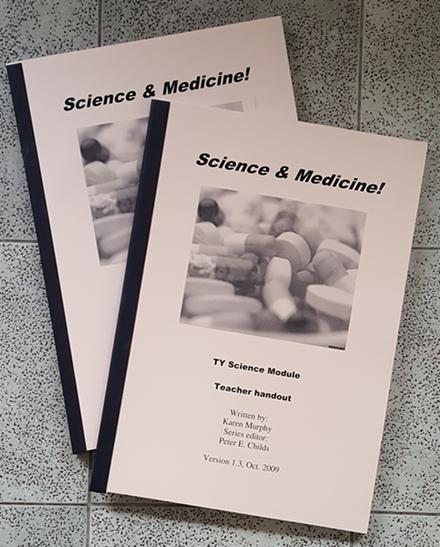
Science and Medicine (Karen Murphy)
Action of antibiotics
Antiseptics
Blocking sensations
Antacids
Analgesics and pain
Importance of medicines
Science and technology in medicine
Why not take the alternative route?

Slide 21
Homemade heroes (Laurie Ryan)
This module was linked to the TEMI project to develop teaching ideas based around mysteries.
Each unit in the 8 week module thus started with a scientific mystery and developed an inquiry-based science unit from it.
e.g. Unit 5 What’s going on? Is about the action of yeast in fermentation

Slide 22

List of units
The disappearing act
Now you see it, now you don’t
Ice, ice baby
What floats your boat?
What’s going on?
Food for thought
Move your body
Bubble trouble

Slide 23
Conclusion - General
The development of TY Science modules by trainee science teachers has been very successful.
Have involved student teachers in an innovative curriculum development project.
Satisfy the TY Science guidelines.
Provide a relevant and active-learning experience of all the sciences to encourage the uptake of the Leaving Certificate Sciences.
The modules have been well received by teachers and are widely used. They have been described as ‘life savers’.
The project has used the energy, enthusiasm and fresh ideas of trainee teachers.
It has also been valuable for the students’ own personal and professional development.

Slide 24
Workshop activity (1)
Get together in a small country/language group.
Brainstorm a suitable topic idea that would interest a specific group of students in your country (select age etc.)
Brainstorm sub-topics that would make up a module – select length of module e.g. 2/4/6/8 weeks. One sub-topic per week.

Slide 25
Workshop activity (2)
Take one sub-topic and discuss how you would introduce it, what activities you could use, how the unit would be structured.
How would you evaluate the unit/module in a classroom setting?
How might you pilot it or disseminate it?

Slide 26
Discussion

