Slide 1
www.erasmus-artist.eu

Slide 2
This project has been funded with support from the European Commission.
This publication [communication] reflects the views only of the author,
and the Commission cannot be held responsible for any use which may be
made of the information contained therein.

Slide 3
Preparing an Action Research publication
Ingo Eilks

Slide 4
Overview
Types of publications in science education
How to select a publication type
How to start
Tipps for starting to write
www.erasmus-artist.eu

Slide 5
Types of publications in science education

Slide 6
Types of publications
Articles in international journals
Articles in national (teacher) journals
Chapter in books (national or international)
Monograph
Teaching materials collections
Self-prints
Internet
www.erasmus-artist.eu

Slide 7
How to select a publication type

Slide 8
Criteria for selection: Why?
Focus (research/practice)
Availability (access, spread, acknowledgment, …)
Reputation
Formal quality
What do I want? Influence on practice or reputation for own promotion.
www.erasmus-artist.eu

Slide 9
Criteria for selection: What?
Empirical research findings
Report on the development of an innovation
Report on the teacher learning process
Description of an innovation or changed teaching strategy
Developed teaching materials
What do I have to offer and who might make use of it?
www.erasmus-artist.eu

Slide 10
Criteria for selection: To whom?
Colleagues in one‘s own school
Teachers in the region/country
National research community
International community
Reputation
Influence
on practice
www.erasmus-artist.eu

Slide 11
Criteria for selection. Where?
Self-print, Internet
Newsletters
National teacher journal, book
International journal, book
Reputation
Influence
on practice
www.erasmus-artist.eu

Slide 12
How to start?

Slide 13
Selection of the publication type
Character of the content and is documentation
Degree of formal empirical foundation
Target group (teachers or research community)
Intention
Time dimension
In case, criteria set up by my own institution
www.erasmus-artist.eu

Slide 14
Preparation of the manuscript
Read careful the instructions for authors, respect formal guidance, i.e. the way how to cite.
Learn from publications of the same type.
Learn from previous articles in the same journal or publication type, e.g. length, structure, referencing, language used, ….
Think about the use of figures, tables, sketches. Visual material is generally appreciated.
In some journals and in most book projects one can ask the editors whether a certain idea would fit.
www.erasmus-artist.eu

Slide 15
Respect common practices
Traditional structure of most research papers
Abstract
Introduction
Theoretical framework
Research question
Method and sample, in case intervention
Findings
Discussion
Conclusion and implications
www.erasmus-artist.eu

Slide 16
Tipps?

Slide 17
Tipps: Citations
Better cite one‘s more than one‘s less, check how many citations a paper in the publication medium generally has.
Use references to own work well dosed (in international publications use own non-English references very limited).
In international publications use non-English references very well dosed.
Check the corresponding journal carefully for all relevant prior publications and refer to them.
This is bit like a game where you can learn the rules
from experienced and successful authors.
www.erasmus-artist.eu

Slide 18
Tipps: First approaches
Start small: National publications, conference papers, teacher journals can help to gain experience with a higher chance of success.
Reflect and discuss experiences with experienced colleagues or advisors.
Break down complex projects into smaller units. Sometimes it is easier to publish a project in different units.
Keep brave. A rejection does not mean that a paper cannot be published – it only says that it cannot be published in a certain medium in its current form.
Learn from editors feedback and in case go somewhere else.
www.erasmus-artist.eu

Slide 19
Tipps: Journals
New journals are generally more tolerant, they need your manuscript to develop their recognition.
Theme issues and theme issues editors might be more interested in your research, than editors in general, since they might wait for your contribution.
Look whether there are journals with a natinal or regional focus, make clear your focus and why it fits.
www.erasmus-artist.eu

Slide 20
Tipps: Formalia
Work carefully: Any formal issues or neglection to necessary works will be identified by reviewers and editors.
Take care that the language quality is well: Any reviewer or editor identifying problems in language will look more critical also on the content.
Ask friends: You can ask friends to review your MS before it goes into formal review. Maybe a friend can identify any shortcomings in a MS before submission.
www.erasmus-artist.eu

Slide 21
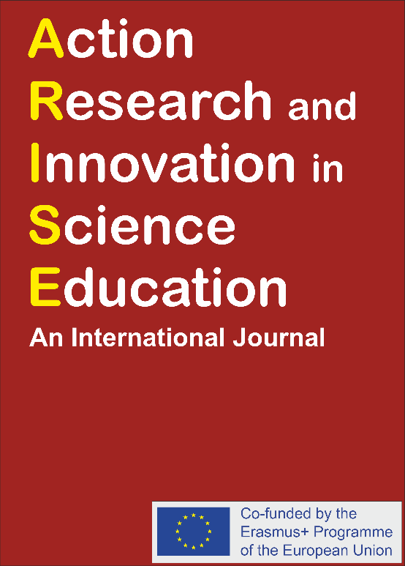
ARISE
ARISE (Action Research and Innovation in Science Education) is an online free access journal aiming at teacher research and small scale curriculum devlopment studies (evidence based)
www.arisejournal.com
www.erasmus-artist.eu

