Slide 1
www.erasmus-artist.eu

Slide 2
This project has been funded with support from the European Commission.
This publication [communication] reflects the views only of the author,
and the Commission cannot be held responsible for any use which may be
made of the information contained therein.

Slide 3
An empirical case on the professional development of teachers Ingo Eilks

Slide 4
Rationale
Participatory Action Research (PAR) as a systemic framework for practice improvement, curriculum development, and educational research in science education
Reflecting 20 years research by / on PAR in science education
www.erasmus-artist.eu

Slide 5
Participatory Action Research as a systemic framework for practice improvement, educational research, and curriculum development in science education

Slide 6
Objectives of our PAR model
Objectives of any
domain-specific
educational research
Objectives inspired by
any Action Research approach
(e.g. Eilks & Ralle, 2002; Eilks, 2003)
www.erasmus-artist.eu

Slide 7
Pillars of our PAR model
Input from
domain-specific
educational research
Input from
teachers
(e.g. Eilks & Ralle, 2002; Eilks, 2003)
www.erasmus-artist.eu

Slide 8
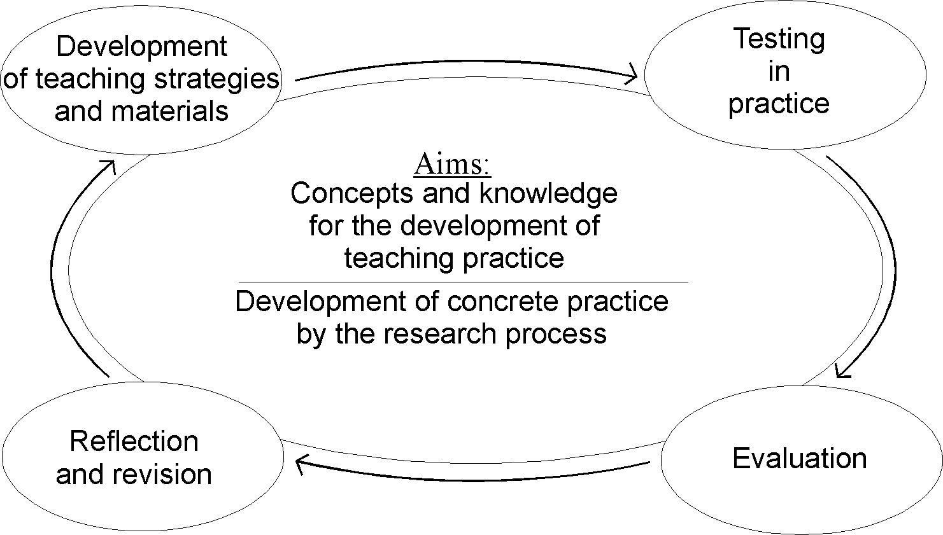
The Action Research Cycle
(e.g. Eilks & Ralle, 2002; Eilks, 2003)
www.erasmus-artist.eu

Slide 9
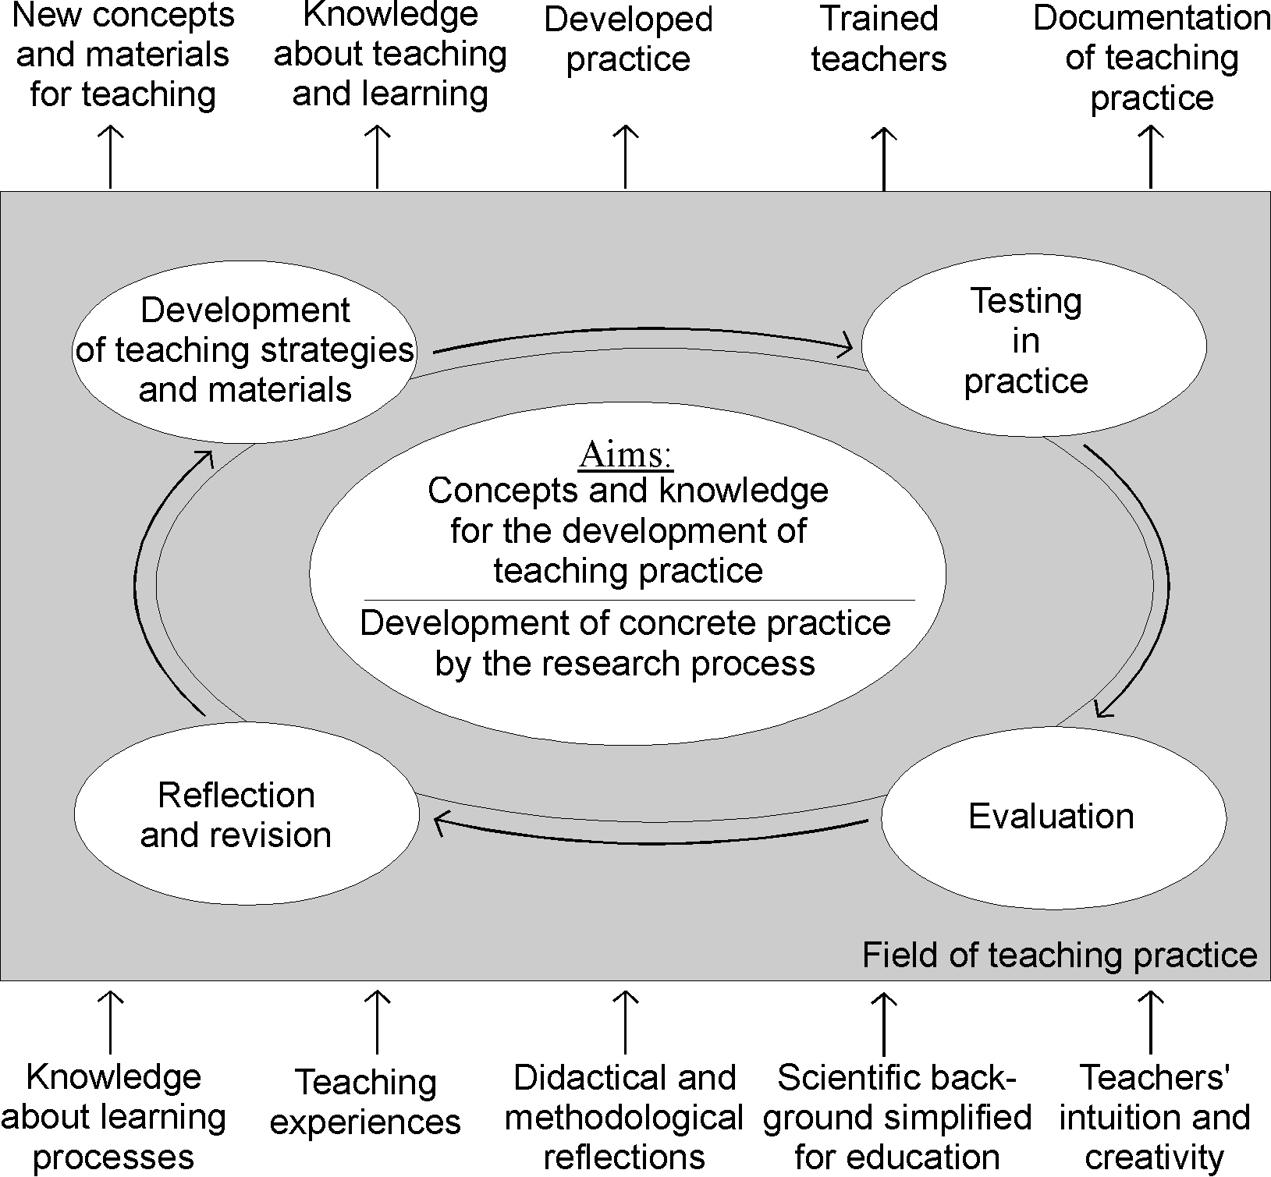
PAR in science education
(e.g. Eilks & Ralle, 2002; Eilks, 2003)
www.erasmus-artist.eu

Slide 10
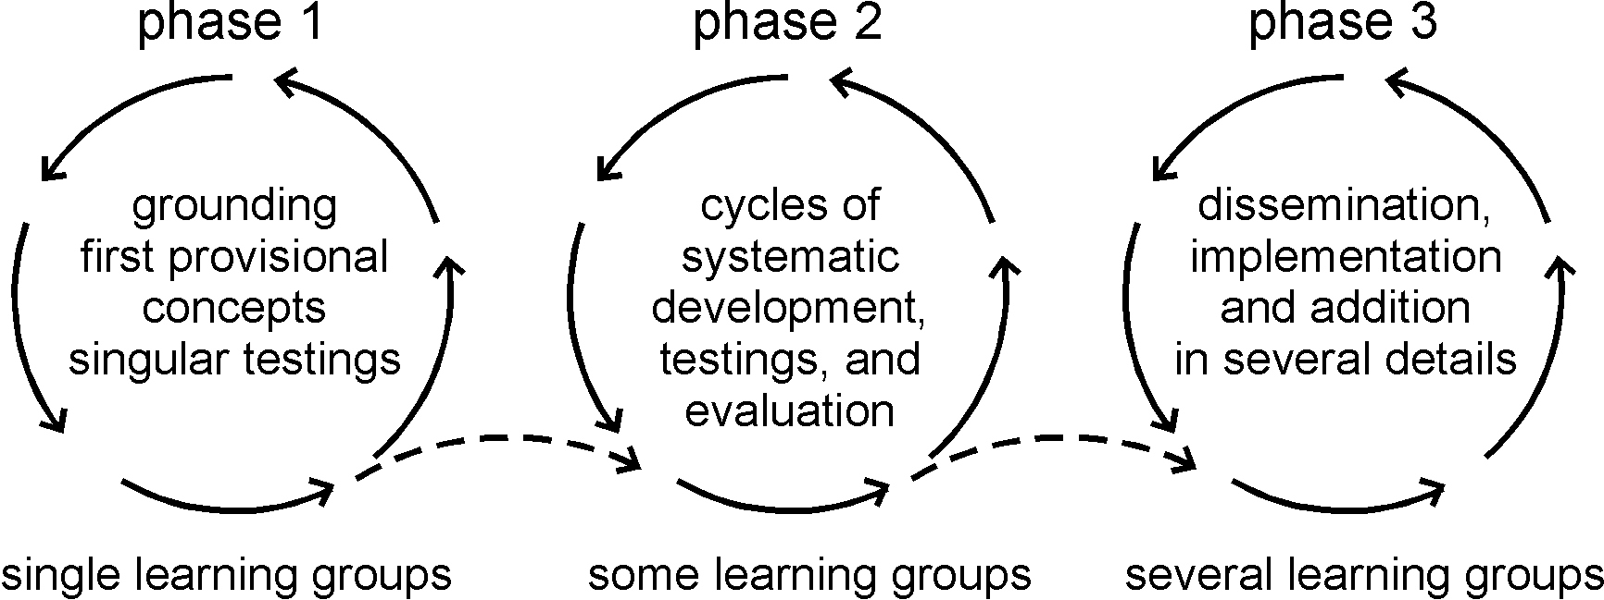
Three stages of development and implementation
(e.g. Eilks & Ralle, 2002; Eilks, 2003)
www.erasmus-artist.eu

Slide 11
In practice
Groups of approx. 10 teachers/educators
Meeting every 4 weeks, one afternoon
Analyzing problems, disussing new ideas, exchanging experiences, reflecting, revising
Different group on different projects
New ways towards the particulate nature of matter
Cooperative learning in the chemistry classroom
The socio-critical and problem-oriented approach to science teaching
Education for Sustainable Development (UNESCO World DESD project)
Linguistic heterogeneity in science teaching
Interdisciplinary science education in PROFILES-Bremen (FP7)
One of the groups works now for ~20 years.
(e.g. Eilks & Ralle, 2002; Eilks, 2003)
www.erasmus-artist.eu

Slide 12
Reflecting on 20 years research by / on PAR in science education

Slide 13
Data on the teachers reflection about their role and professional development
Collection and evaluation
Open questionnaires each summer, on teachers reflection of the process and its outputs.
Group discussions inspired by the questionnaire (45-60 min.), audio taped and transcribed
Data analysed by a Qualitative Content Analysis
Data collection from June 2000 and to June 2006 analysed; saturation of data after year 4/5.
(Eilks 2003; Eilks & Markic 2011; Mamlok-Naaman & Eilks, 2011)
www.erasmus-artist.eu

Slide 14
Teachers’ view: Process
Expectation
in the
beginning
Applying pre-structured teaching modules
as basis for evaluation
Change in the
first year
Helping to develop teaching modules that
fit the needs and restrictions of practice
Change in
year 2/3
Being an active part in all steps of the
development of new teaching modules
Initiating changes, working self-standing
within the group
Role now
www.erasmus-artist.eu

Slide 15
Teachers’ view: Process
” ... from a teacher, who wanted to be in-service trained,
towards a colleague and convinced promoter of the
new concept.”
or
” ... from a receiver within a group to an activist”.
Teachers feel themselves to “become more aware about the needs of change but also to become more open for alternative teaching.”
www.erasmus-artist.eu

Slide 16
Teachers’ view: Practice
Consideration
in the
beginning
Careful retention against new didactical
structures and methods
Change in the
first year
Growth of acceptance for the need of change
Familiarisation with the new concepts
Change in
year 2/3
Ownership of the commonly developed (“own”) concepts
Promoting and implementing the ideas, e.g.,
school book writing, syllabus commission
Role now
www.erasmus-artist.eu

Slide 17
Teachers’ view: Practice
”A conviction to change one's own practice only
will take place among teachers if based
on one's own experiences".
“... becoming more reflective and
critical concerning one's own previous practice".
teachers look on publications in teachers
journals now “with another view”.
teachers pointed out to have learned about
"own [teachers’] misconceptions about students' learning".
www.erasmus-artist.eu

Slide 18
Grundy‘s three modes of AR
(from Grundy, in Kemmis/McTaggert 1988)
www.erasmus-artist.eu

Slide 19
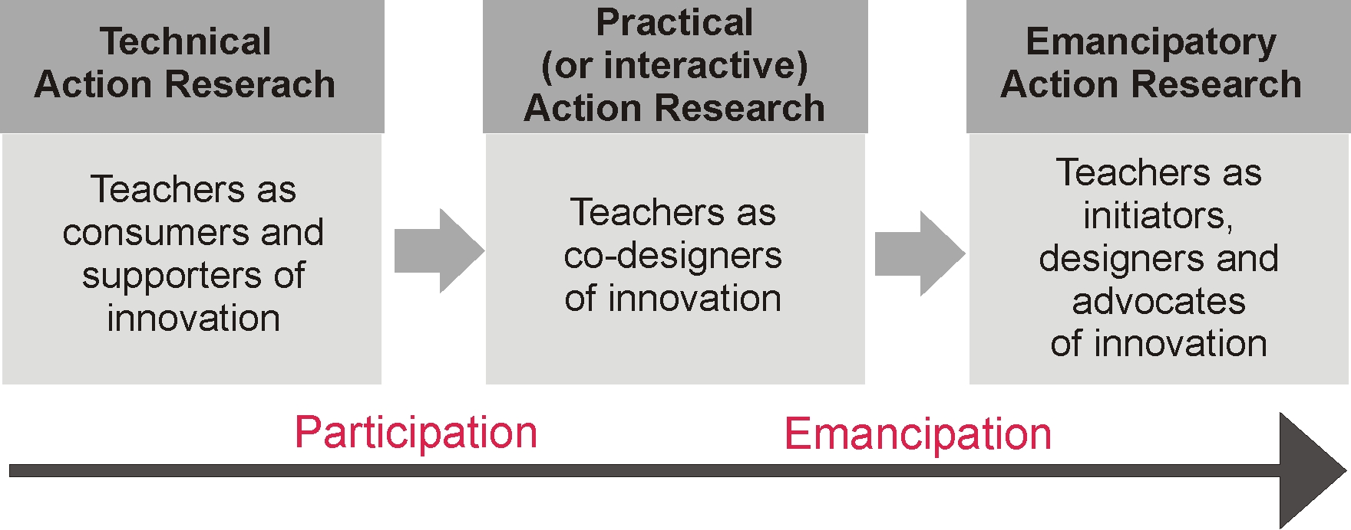
Re-interpreting our use of the Grundy model
(Eilks & Markic 2011; Mamlok-Naaman & Eilks, 2011)
www.erasmus-artist.eu

Slide 20
Conclusion

Slide 21
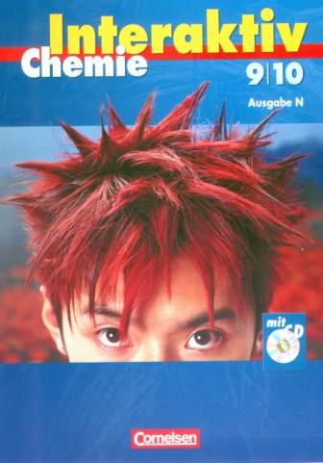
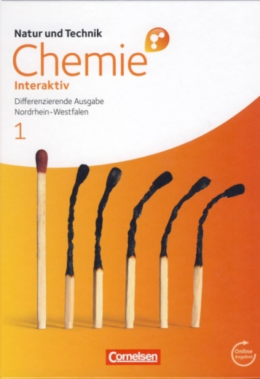
Output in 20 years
~ 20 secondary school textbooks and teacher guides
~ 150 papers in science teachers‘ journals
~ 50 papers in refereed international journals and books
… most of them with the teachers being (co-)authors.
www.erasmus-artist.eu

Slide 22
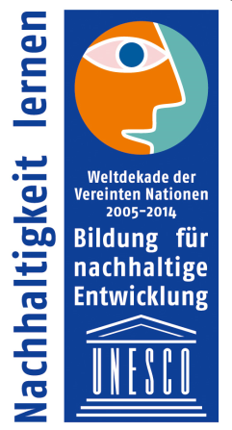
Conclusions
PAR in science education provides strong, long-term and sustainable CPD
All teachers developed high expertise and improved their critical/emancipatory attitudes.
Some of the teachers became teacher trainers, three made a PhD in projects with the group, some became textbook authors, …
Sustainable change took place in the schools, e.g. the school science curricula and pedagogies
Some projects and schools were awarded, e.g. by UNESCO-DESD or the ACS-CEI Award for Incorporating Sustainability into Chemistry Education 2017.
www.erasmus-artist.eu

Slide 23
Conclusions
Cooperation of researchers and teachers secure:
Sufficient recognition of research evidence
Feasibility of the new approaches
Relevance, authenticity, and credibility
Dissemination to practice and research
Dissemination becomes possible, e.g. via textbook work and making the participants pre- and in-service trainers.
… but only due to the close, long-term cooperation of teachers and academic professionals.
www.erasmus-artist.eu

Slide 24
Selected publications
Eilks, I., & Ralle, B. (2002). Participatory Action Research in chemical education. in: B. Ralle, I. Eilks: Research in Chemical Education - What does this mean? (pp. 87-98). Aachen: Shaker.
Eilks, I. (2003). Co-operative curriculum development in a project of Participatory Action Research within chemical education: Teachers' reflections. Science Education International, 14 (4), 41-49.
Eilks, I. & Markic, S. (2011). Effects of a long-term Participatory Action Research project on science teachers’ professional development. Eurasia Journal of Mathematics, Science and Technology Education, 7(3), 149-160.
Mamlok-Naaman, R., & Eilks, I. (2011). Action research to promote chemistry teachers’ professional development – Cases and experiences from Israel and Germany. International Journal of Mathematics and Science Education, 10, 581-610.
Eilks, I., (2014). Action Research in science education: From a general justification to a specific model in practice. In T. Stern, F. Rauch, A. Schuster, & A. Townsend (eds.), Action research, innovation and change (pp. 156-176). London: Routledge.
Laudonia, I., Mamlok-Naaman, R., Abels, S., & Eilks, I. (2018). Action research in science education - An analytical review of the literature. Educational Action Research, 26, 480-496.
www.erasmus-artist.eu

