Slide 1
www.erasmus-artist.eu

Slide 2
This project has been funded with support from the European Commission.
This publication [communication] reflects the views only of the authors,
and the Commission cannot be held responsible for any use which may be
made of the information contained therein.

Slide 3
Improving the understanding of the topics: elements, compounds and mixtures in microscopic and macroscopic scales among eighth graders
Ahmad Basheer¹ & Ayshi sindiani²
¹The Arab Academic College for Education in Israel - Haifa
²Secondary school “A”- Jaffa- Nazareth

Slide 4
Purpose of research
"The role of education is to teach the child to think, not to teach him what to think" (John Dewey).
Thinking is a complex cognitive activity without which active learning will not occur.
The present study is designed to describe the effect of an intervention program (simulations and modeling) in the topics “elements, compounds and mixtures“, on improving the understanding of these topics among 8th grade.

Slide 5
Research questions
What are the common misconceptions about the elements, compounds and mixtures at the microscopic and macroscopic levels among eighth graders?
Will the activation of an intervention program affect the conceptual change among 8th graders on the topics: elements, compounds and mixtures?

Slide 6
Research process
Choosing students to participate in the study and filling a pre-test
The topics, elements, compounds and mixtures were studied for 18 lessons. During the lessons simulations and models were integrated to illustrate the subjects. During the teaching, the microscopic and macroscopic aspects was emphasized
The students answered a post-test and underwent interview (after the intervention program based on the constructivist approach)
Then the findings were analyzed and conclusions were drawn

Slide 7
Activity number 1: Electronic Activities + Simulation
Examines the misconception:
All materials are made up of molecules
The purpose:
Explain the difference between the molecular and ionic materials
Details of activity
Part I: Electronic activity to construct molecular molecules such as H₂O, C₆H₁₂O₆…
Part II: Simulation and models explaining the structure of ionic materials e.g. NaCl..

Slide 8
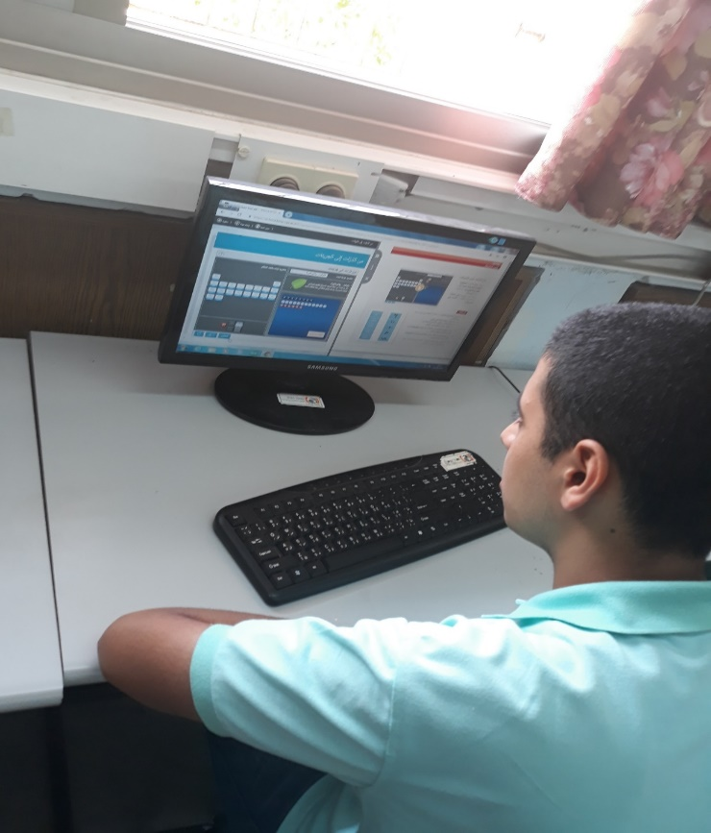
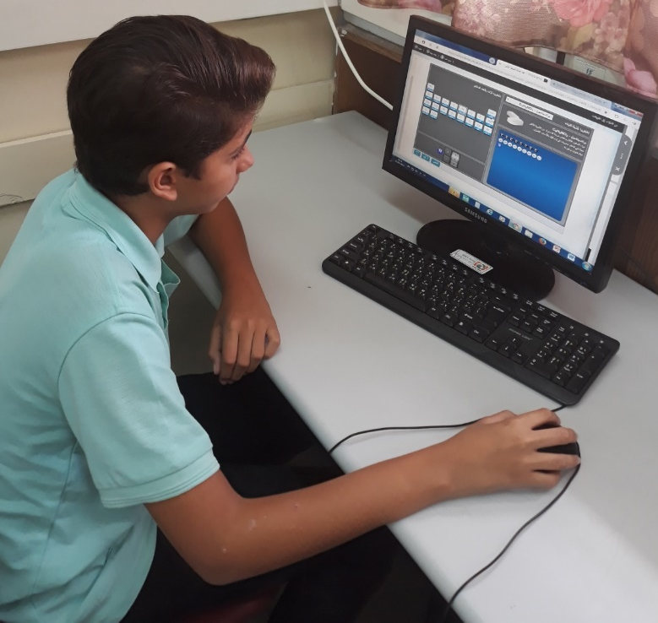
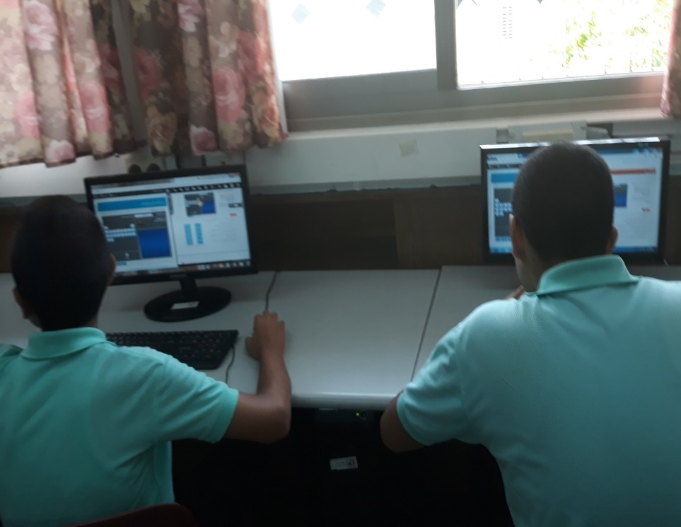
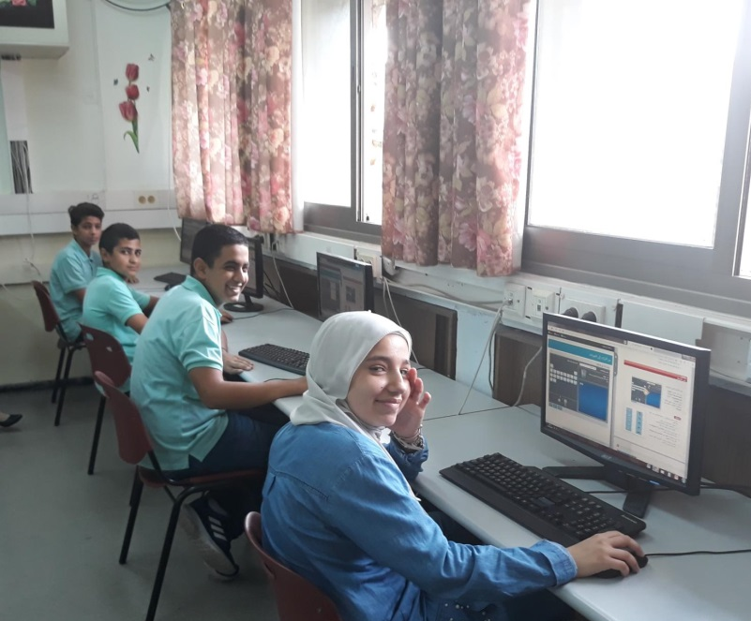
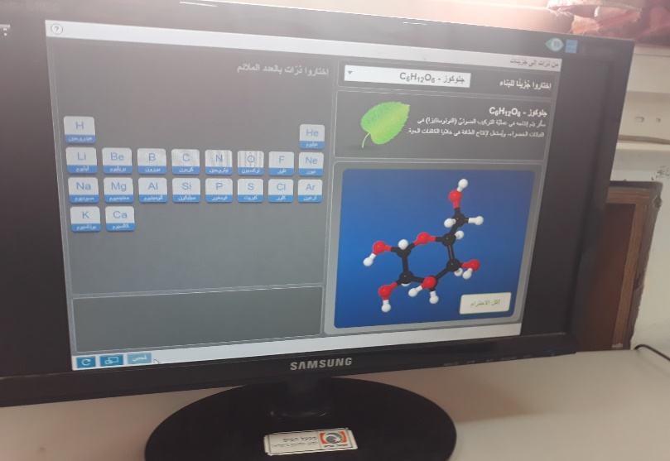
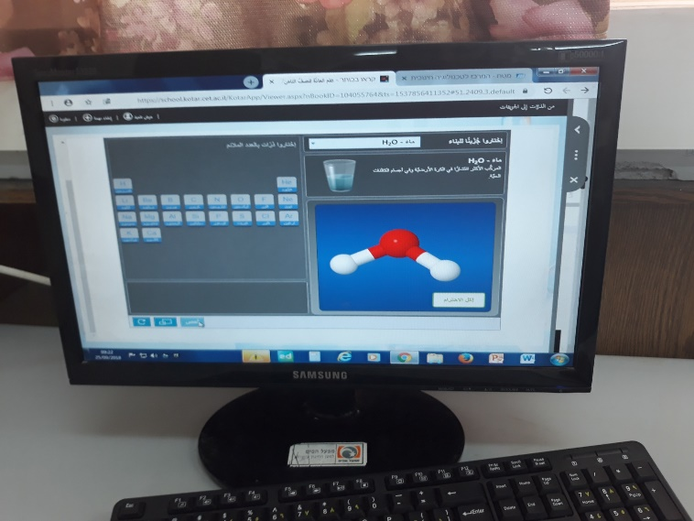
Part I : Electronic activity to construct molecular molecules such as H₂O, C₆H₁₂O_{6 …}

Slide 9
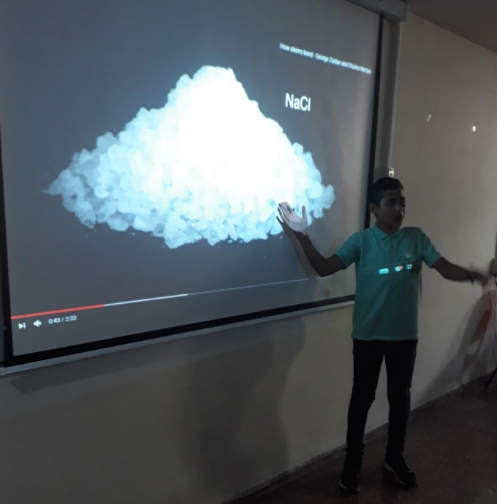
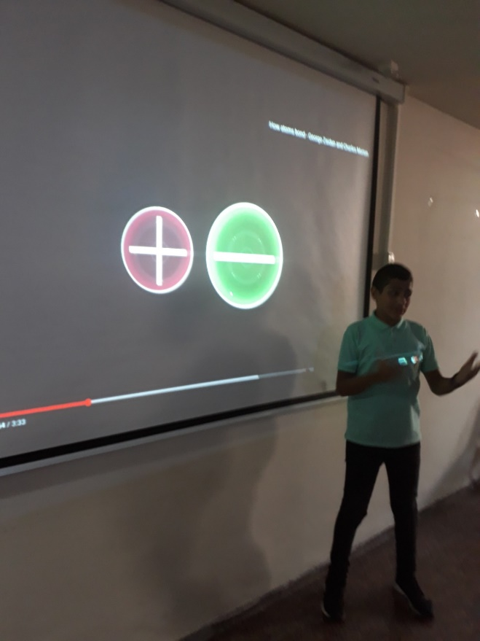
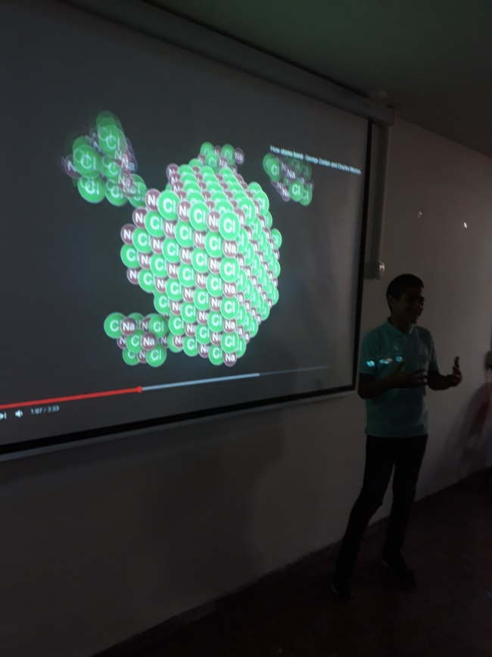
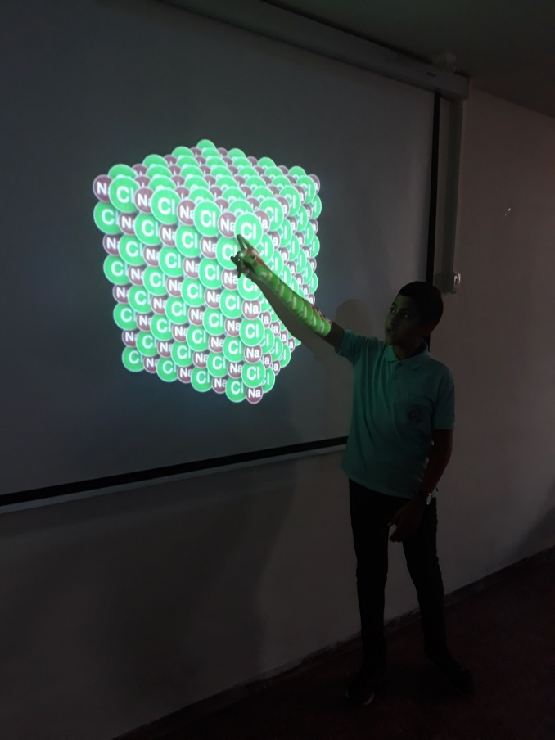
Part II : Simulation explaining the structure of ionic materials

Slide 10
Activity number 2: Modular construction
Examines the misconception
Only the elements are pure matters
The purpose:
To explain that both elements and compounds are pure substances
Details of activity
Modeling of elements, compounds and mixtures using Polystyrene balls

Slide 11
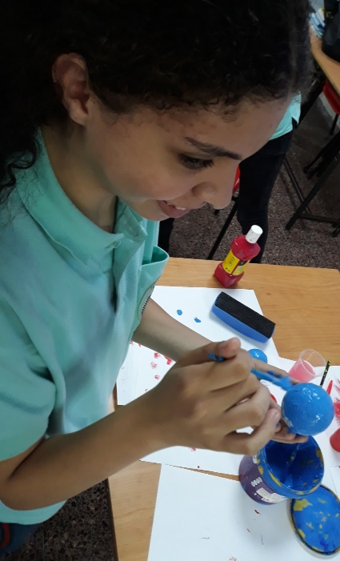
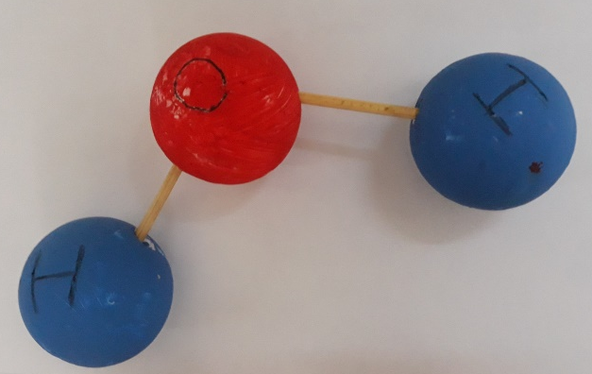
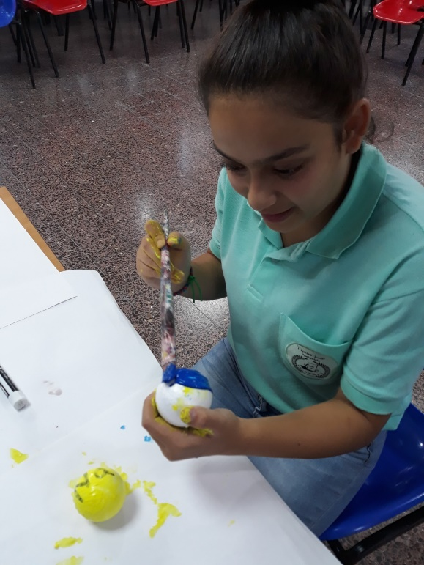
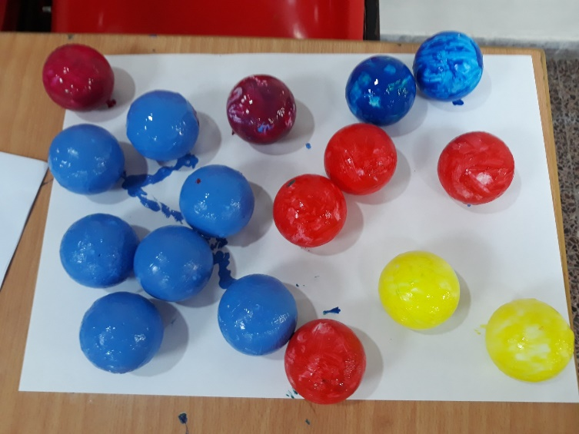
Activity number 2: Modular construction

Slide 12
Activity number 3: Demonstration
Examines the understanding of the subject:
Mixtures and methods of separation
The purpose:
To give an explanation of the mixtures and methods of separation
Details of activity
Part I: An experiment to separate the sand from the water
Part II: Simulation of acetone distillation and water

Slide 13
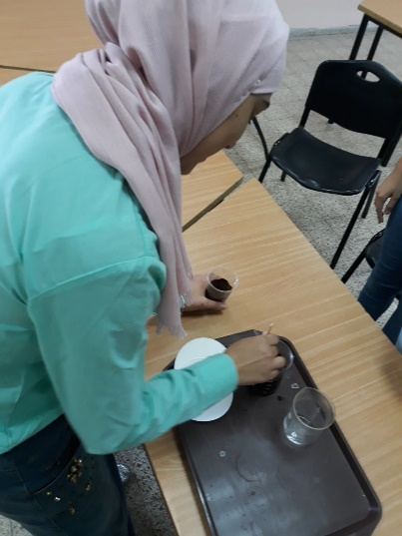
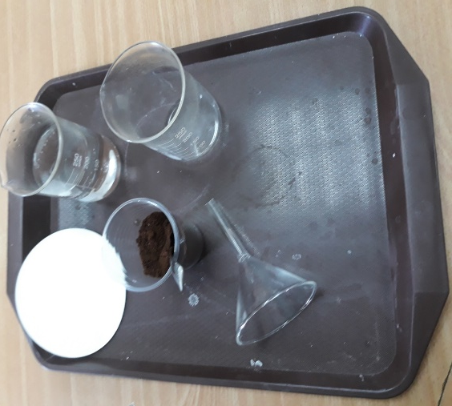
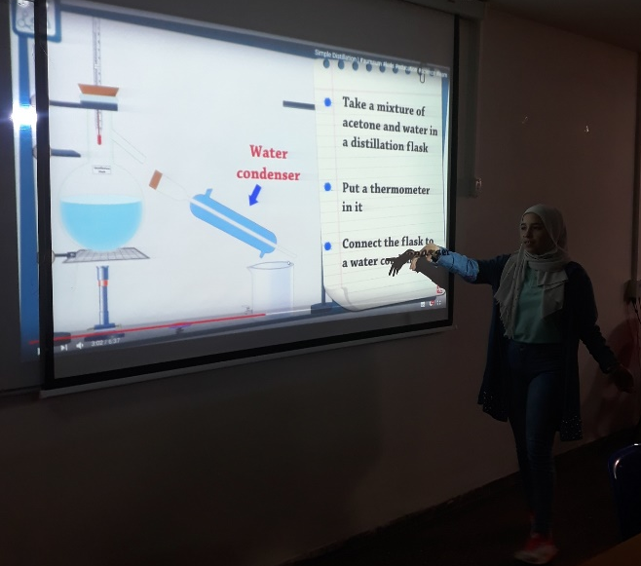
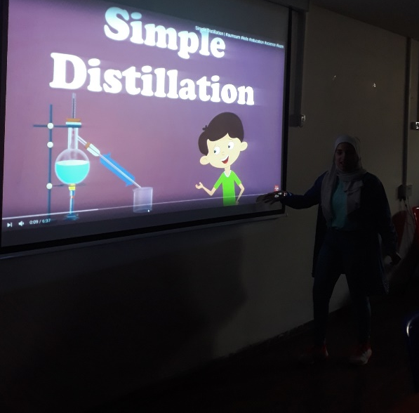
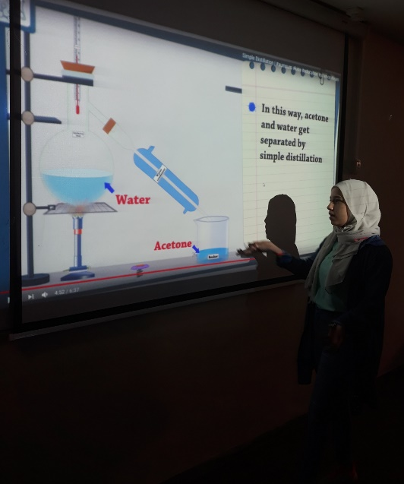
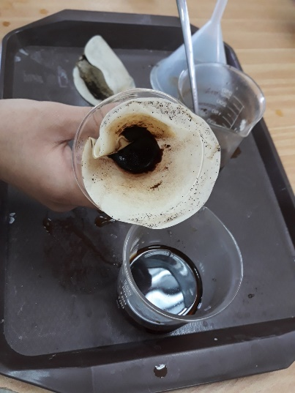
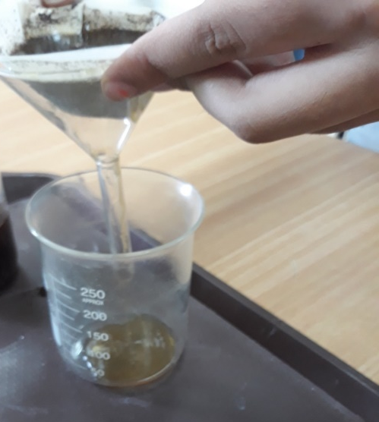
Activity number 3: Demonstration
Part I: An experiment to separate the sand from the water | Part II: Simulation of separation of acetone/water by distillation

Slide 14
Findings
Question: When sugar (C₆H₁₂O₆) dissolves in water (H₂O) it produces pure matter. Right / Wrong?
Sugar is made up of pure molecules and water is also made up of pure molecules, so the solution formed is pure matter.
Sugar is made up of pure molecules and the water is also made of pure molecules, and when mixed, a homogenous mixture is created.
C. Sugar is made up of molecules that are different from the water molecules, so when mixed, a heterogeneous mixture is created.
D. Sugar is a mixture consisting of different types of atoms, so when dissolved in water it produces a mixture.
Before the intervention (%)
After the intervention (%)
The solution is pure material
The solution is a homogeneous mixture
Sugar is a mixture because it produces mixtures from its solutions

Slide 15
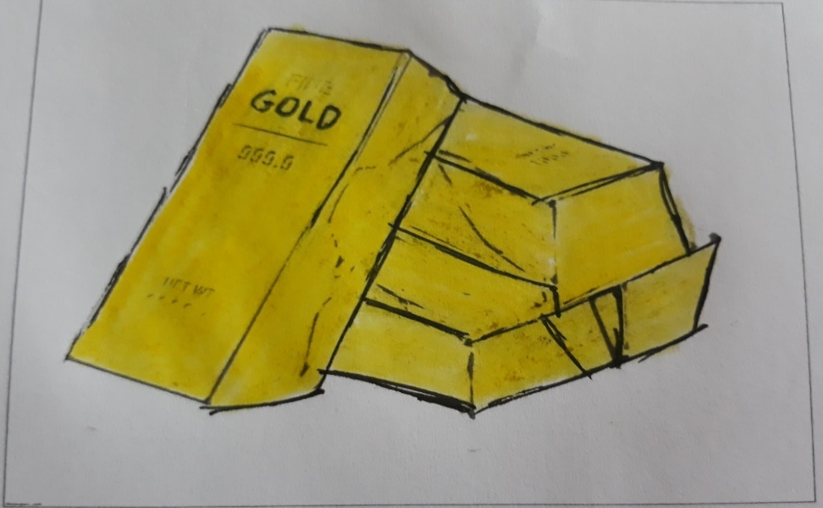
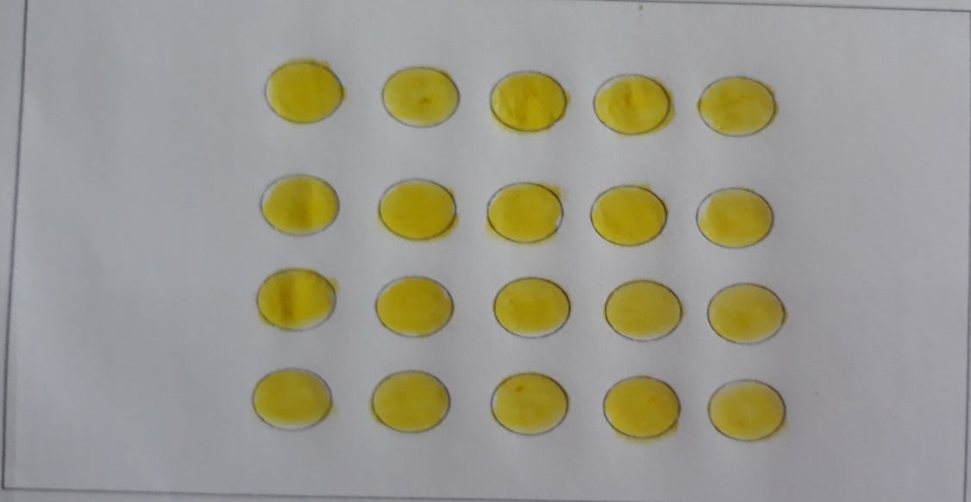
Findings
imagine having a gold alloy:
Before the intervention program
A) Paint the gold alloy | B) Paint the particles that make up the gold alloy
The student claims that because gold is yellow, so is the color of the particles that build it yellow too

Slide 16
Findings
You have water in a liquid state: Write the chemical equation for producing water
Before the intervention program | After the intervention program
The student couldn't write the correct chemical equation for the producing water before the intervention program. This was changed after…

Slide 17
Findings
Imagine that you have 10 particles (molecules) of water, draw the particle structure of each of the substances you recorded in the chemical equation
Before the intervention program | After the intervention program
+
+
Before the intervention program most students was unable to paint correctly at the microscopic level the particle structure of each of the substances recorded in the chemical equation. The situation improved after the intervention program

Slide 18
Findings
After the intervention program
Draw an illustration of sodium chloride NaCl in water | Draw structure of the sodium chloride compound NaCl:
After the intervention program, most students were able to paint the structure of the salt, and its shape when dissolved in water. The orientation still not clear for students after the intervention

Slide 19
Findings
After the intervention program
Draw the water structure H₂O
After the intervention program, the student was able to paint the water structure

Slide 20
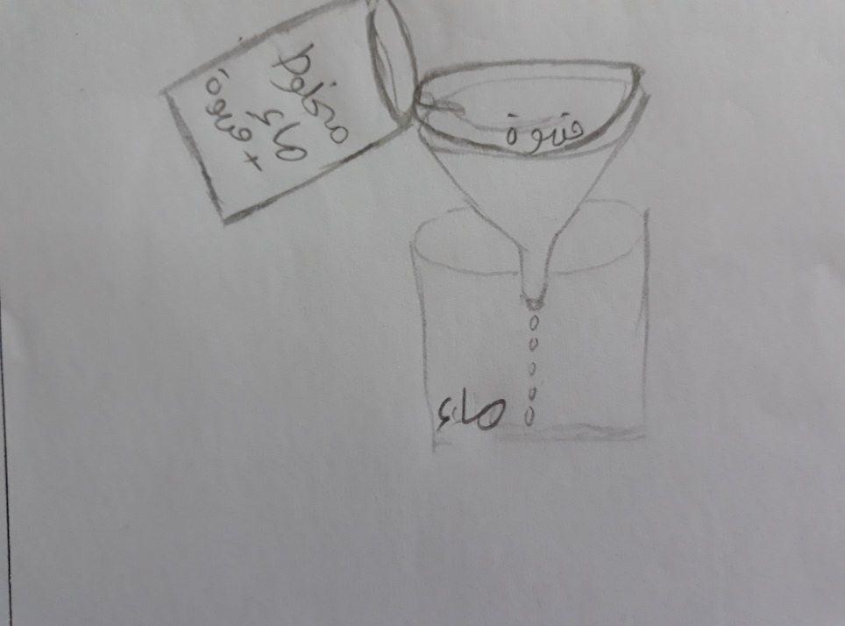
Findings
After the intervention program
Draw one method to separate one component of a mixture you know from your daily life
After the intervention program, the students were able to draw the filtering process as a way to separate the water and coffee mixture

Slide 21
Findings
It was found that 8th graders hold the following misconceptions before the intervention program :
Only the element is pure matter.
The physical properties of all the ingredients materials in the mixture are similar.
The properties of the material are similar to those of the atoms that are built from them (e.g., the sulfur particle is yellow)
All materials are made up of molecules
The situation was changed after the intervention and most students held correct conceptions instead of the misconceptions described above.

Slide 22
Conclusions
Students find it difficult to cope with the microscopic and macroscopic levels, so they confuse and give the properties of the material at the macro level to particles at the micro level. This is because there is a great distance between the microscopic and macroscopic levels, which eventually leads to various misconceptions.
The teacher must believe and implement the new goals of teaching and learning based on the constructivist approach that emphasizes the development of “Thinking learner" and not only to transfer the knowledge, therefore the learner become partner in the process of learning and building her knowledge student-centered teaching.

