Slide 1
Generating PCK by listening to a student: a case from physics teaching and learning
MEHMET FATİH TAŞAR
Gazi Üniversitesi
Ankara, TURKEY
De La Salle University
Manila, May 18, 2018

Slide 2
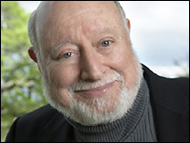
Introduction - PCK
For more than 25 years now Lee Shulman’s seminal works on PCK have been very influential in the field.

Slide 3
Introduction - PCK
In his work
he suggests distinguishing between three types of knowledge:
Subject matter knowledge
Pedagogical content knowledge
Curricular knowledge

Slide 4
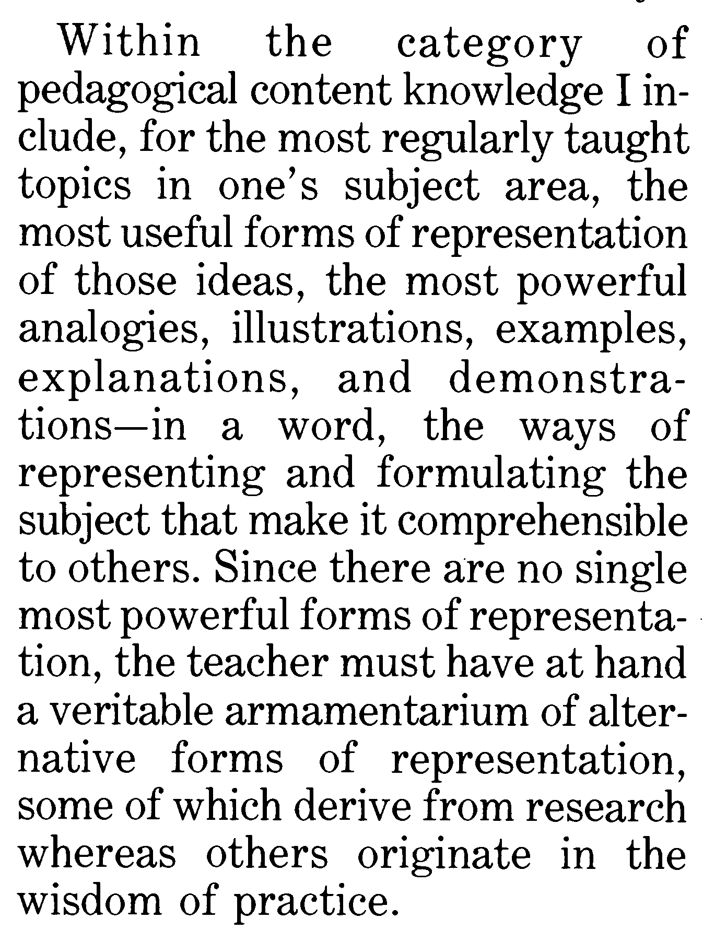
Shulman (1986)
How do we teach science?
What helps during teaching and learning?
What is successful teaching?
When do we learn the essence of a concept?

Slide 5
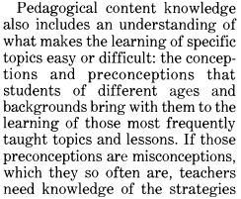
“In the wisdom of practice …”
Science is full of concepts which may become a nightmare for learners if the essence cannot be captured.

Slide 6
“ Teachers need knowledge of the strategies most likely to be fruitful … ”
But!
Where does that knowledge come from?
Where is the wisdom of practice?

Slide 7
“ Teachers need knowledge of the strategies most likely to be fruitful … ”
When we teach in large classes we cannot interact with our students.
They rarely can have an opportunity to ask a question.
However, when we talk to them and let them speak, then we open an avenue for mutual understanding.

Slide 8
“ Teachers need knowledge of the strategies most likely to be fruitful … ”
Physics teachers sometimes tend to think that students are not putting in as much effort as needed to learn.
As an expert they can’t see sometimes why a particular concept is too difficult to learn.
Are there concepts that are too difficult to learn even for the most hard working students?
And if yes, how can we help them learn better and master a concept efficiently?
This presentation is going to try to give an answer to these questions.

Slide 9
The context
This study reports a case study that investigated in detail one female freshman university student's alternative conceptions, alternative framework and learning of force and motion during a short small group instruction and subsequent tutoring interviews.
The researcher in this study acted as the teacher of the small group and the tutor for the interviews. The student who participated in this study had a very limited physics learning experience.

Slide 10
Getting Down to Focus
GENERAL I TY
• Science Education
• Educational Psychology
FIELD OF RESEARCH
• Cognitive Psychology
• Cognitive Science
• Constructivist view of Science Education
• Conceptual Change Learning
• Students’ Alternative Conceptions & Frameworks
• Cognitive Structure/
Knowledge Organization
• Cognitive Styles as
Individual Differences
in Cognition
THEORETICAL FRAMEWORK
The need for learning process studies that also pay attention to
the context of teaching and learning, and interactions that might take place.
PROBLEM
To describe, explain and explore through an in-depth investigation
PURPOSE
of learning process of one student about force and motion in context.
SPECIFITY
☹
RESEARCH QUESTIONS
What is the student's alternative conceptions and framework about force and motion?
What is the nature of the student's learning both during interaction with the teacher-researcher and in the long term?
THE CASE

Slide 11
Descriptive Framework
High degree of investigator – participant (teacher – student) interaction
An investigative context which also included elements of a naturalistic setting
A long term investigation
Triangulation of data sources and data collection methods
A descriptive, exploratory, and explanatory qualitative case study

Slide 12
Data Sources
Tutoring Interview Transcripts - 5 hrs (Audio Taped)
Transcripts of selected segments of small group instruction (3 days/6 hrs) (Video Taped)
Pre/Post-instruction Tests (Written)
One student Journal Entry (Written)
Word Association Task (Written)
Uniformly Varied Force Questionnaire (UVFQ) (Researcher Designed – Written)
Force and Motion Conceptual Evaluation (Thornton & Sokoloff, 1998) (Written)
A Cognitive Style Test (GEFT) (Written)

Slide 13
Data Analysis
Ongoing and cyclic analysis of holistic data set
The researcher was deeply immersed in the data set for about two years
Data were closely examined and elements were identified
The student’s alternative conceptions were constructed from these data elements
Alternative conceptions were synthesized to model the student’s alternative framework and learning

Slide 14
June’s alternative conceptions:
the earth pulls the bigger objects more (bigger force)
during free fall speed (s) is a function of both the height (h) from which the object is released and its mass (m). That is, s → s (h, m)
bigger forces exist in bigger masses or bigger masses carry bigger forces (F ~ m)
bigger force means bigger speed (F ~ s)
acceleration is not at what rate the speed changes but rather just an indicator of whether or not an object is speeding up

Slide 15
The more, the more; the less, the less.
The more the height, the more the weight.

Slide 16
The more, the more; the less, the less.
The bigger the size,
the bigger the volume.

Slide 17
Data: 2nd Tutoring Interview
(Interview Excerpt 2.7, lines 176-189)
June: OK, velocity is still increasing but it is not..
FT:.. it is not increasing as much...
June: .. of increase is not as much.
FT: Yeah. The amount of increase is not as much, because the acceleration is not greater as much.
June: Okay, I got it! It is like the population problems where when they say there is a decrease in population that doesn’t really mean that because there.. it just means there is a decrease in the rate of growth of population.
FT: If they say the population is decreasing that means that the population is decreasing. But if they say last year the rate of increase of population is 2% and this year it is 1% your population is still increasing but not as much as last year.
June: Great. Okay.
FT: Good analogy, I like that.
June: [smiles]

Slide 18
This was the moment a PCK was generated by a learner
Such a powerful analogy did not exist in the literature before.
It reveals why the student was not able to grasp the true meaning of the concept of acceleration.
It can be used in physics lessons to explain the relationship between force and motion and overcome similar difficulties.

Slide 19
Data: Tutoring Interview (Exactly 1 year after the first tutoring interview)
F ~ a OR F ~ v ?
Force
F₁
Time
0
t₀
t₁
t₂
t₃
t₄
-F₁
Right at t₀ the velocity will reach its maximum, and then on will gradually decrease.
At t₀ and t₄ velocity will have its maximum value.
At t₂ where force becomes zero velocity will be zero, too.
At t₂ the object will stop momentarily.
At t₂ the object's direction of movement will be reversed.
At t₄ the object will be at the point where it started its motion.

Slide 20
Results
June’s alternative conceptions of force and motion (including free fall) were similar to student conceptions documented in the literature (e.g., Driver, et al., 1994), which are usually characterized as pre-Newtonian
June’s conceptions were extremely resistant to change over the course of the study
June’s alternative framework remained intact
Data revealed that understanding acceleration in relation to force and speed played a central role in learning motion on a horizontal line and during free fall
The findings also exemplified how by listening to students carefully and patiently new PCK could be generated.

Slide 21
Connecting to the literature
von Glasersfeld (1992) points out:
“… teachers may assume that their students have understood, when they act and respond in ways that seem compatible with the teacher's understanding. But if a student merely repeats what the teacher or the textbook have said, this is of course no indication of a conceptual fit.” (p.34)
diSessa (2002) asserts:
“I advocate moving from before/after studies, and studies that use only constructs (like coding categories) distanced from cogent theoretical terms, to the use of process data to test and illustrate theoretical commitments about concepts, or other theoretical elements of mind, in use and in change.”

Slide 22
I will leave you with this big question:
Are we listening to our students enough or at all?

Slide 23
Thank you!.
MEHMET FATİH TAŞAR
mftasar@gazi.edu.tr
Gazi Üniversitesi
Ankara, TURKEY

