Slide 1
www.erasmus-artist.eu

Slide 2
This project has been funded with support from the European Commission.
This publication [communication] reflects the views only of the authors,
and the Commission cannot be held responsible for any use which may be
made of the information contained therein.

Slide 3
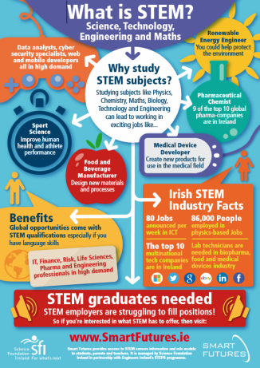
Education-Industry networks and career orientation
University of Limerick ARTIST team
ARTIST Workshops 2018

Slide 4
The problem
A frequently raised issue in science education at school is that students and their parents, and often their teachers, do not know what scientists do in industry and what sorts of career opportunities there are in science or using science.

Slide 5
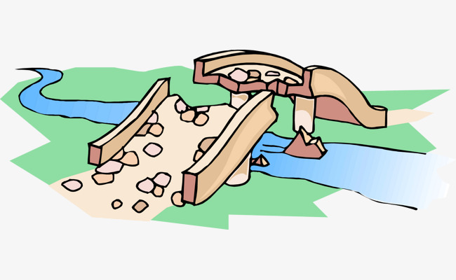
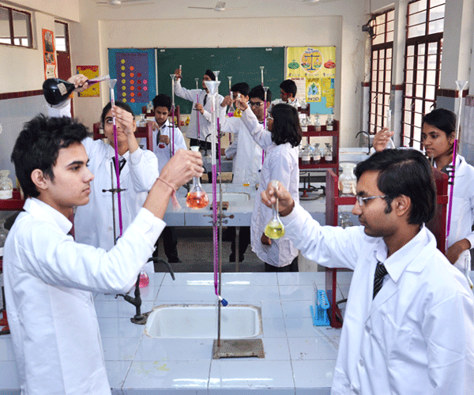
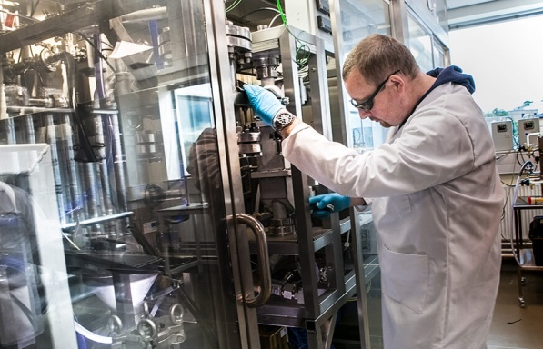
An information gap
Schools Industry

Slide 6
Where can STEM lead you?
Almost anywhere:
but students and teachers
don’t always know this.

Slide 7
How to bridge the gap?
What can we do to improve liaison and interchange between education and industry using education-industry networks?
Although there are general features common to STEM-based industries worldwide, the approach and materials and examples must be specific to the country, culture and language.

Slide 8
Three main areas
Curricula
Contexts
Careers
Curricula
Careers
Contexts

Slide 9
1. Curricula
School curricula often out-of-date and unconnected to uses of STEM in industry in your country.
Students ask:
“What use is this?”
“What is the point of studying this?”
“How will this help me in my career?”

Slide 10
Connecting school and industry
Teachers and students need to know how science is used in industry and in society and how it connects with the school curriculum.
Science in school Science in industry
Also people in industry need to know what is taught in school science.

Slide 11
How to connect?
Many ways to connect school science curricula and science in industry and society:
Visits to industry by teachers and students.
Visits to schools by scientists.
Teaching materials connecting school science and science in industry e.g. Websites, videos, worksheets, books, posters etc.

Slide 12
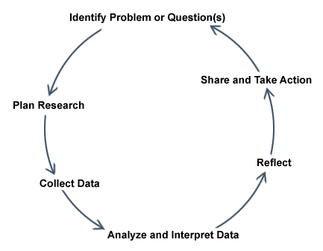
Developing teaching materials using AR
Relevant and engaging teaching materials need to be developed in partnership between teachers in schools and scientists in industry using an AR model.
.

Slide 13
Criteria for teaching materials
Need to match the school curriculum.
Need to match the ability and interests of students.
Need to relate to national/local industry.
Need to have suitable pedagogical design.
Need to be low-cost and readily available.
Need to be interesting, relevant and engaging.

Slide 14
Example: TY Science project at UL
The TY Science project aims to provide teachers with interesting, relevant, context-based materials for TYO (age 15-16).
The overall aim is to make science more interesting, in order to encourage more students to take senior cycle science subjects.
It involves final year trainee science teachers developing teaching modules as a Final Year Project.
Produces low cost teaching materials.

Slide 15
The development of materials
Choose theme
Select topics
Design teaching materials
Identify teachers and schools
Implement module
Evaluate module
Revise module
Disseminate materials
Get feedback on wider use

Slide 16
Module themes
Completed and available to teachers (date of publication) and author
Forensic Science (2004) Sindy Meleady
Cosmetic Science (2004) Audrey O’Grady
The Science of Sport (2004) Maria Sheehan
Science of Survival (2007) Rebecca Moran
Environmental Science (2007) Sarah Hayes
Issues in Science (2009) Ciara Hayes
Science and Medicine (2009) Karen Murphy
Food Science (2009) Anne O’Dwyer
Under revision
Space Science & Technology (2009) Walter Mahony
Science of Cleaning (2010) Maeve Liston
Waste not, want not (2010) Hannah McDonnell
Power for the future (2010) Nicholas Ryan
Science of Toys (2011) Joannah Kennedy
Smart Materials (2011) Martin Sheehan

Slide 17
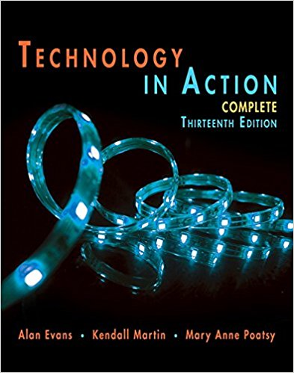
Teaching materials from industry www.sta.ie
Science and Technology in Action (STA) annually produce a set of industry-led lessons, designed to support the teaching of science and related subjects in Irish second level schools.

Slide 18
Courses and projects
Developing teaching programmes in schools e.g. STEAM www.steam-ed.ie/; Discover Primary Science
Project work linked to industry or in collaboration with industry for science fairs.
Industry-sponsored CPD courses for teachers e.g. Amgen teach programme (http://www.amgenteach.eu/ireland; CPD courses run in collaboration with PDST).

Slide 19
Teachers into research and industry - work placement
STARS programme in Ireland (SFI Secondary Teachers Assistant Researchers (STARs) programme, 2004-2009)
Teachers in Industry (www.teachersinindustry.arizona.edu, 2009- )

Slide 20
Lab sessions
Lab sessions in schools or in industry funded by local industry e.g. Eli Lilly, Cork – Introduction to Science day for primary schools. (http://www.lilly.ie/en/responsibility/partnerships/community-engagement.aspx)

Slide 21
Local networks
Industry-Education STEM Alliance in Limerick https://www.ilovelimerick.ie/mid-west-region-stem-alliance-launched/
The joint initiative between the Mid-West Regional Action Plan for Jobs, Mid-West Regional Skills Forum, Limerick for Engineering and Limerick for IT creates a new pilot initiative with 19 post-primary schools under the patronage of the Limerick and Clare Education Training Board.

Slide 22
2. Careers
Knowing about science used in industry and society is not enough.
Students also need to know what scientists do and what career opportunities are available in science and using science.
What sorts of jobs?
What do the jobs involve?
What qualifications are needed?

Slide 23
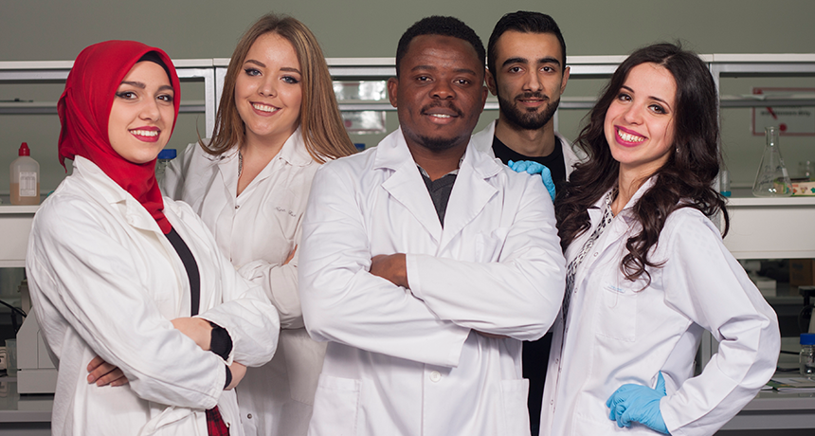
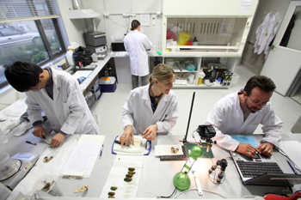
The personal dimension
Career orientation not just about information and facts – students need the personal dimension and good role models.

Slide 24
How to connect?
Visits to industry to talk to scientists and their work.
Visits to schools by scientists to talk about their work.
Career profiles of scientists in different jobs and what their work involves.
e.g. Website, videos, booklets
Work experience in industry and research labs.

Slide 25
Careers
Smart Futures https://www.smartfutures.ie/
STEMreach Paired Science Programme (2017) Waterford IT
https://www.wit.ie/news/education/paired-science-programme-brings-local-industry-and-schools-together

Slide 26
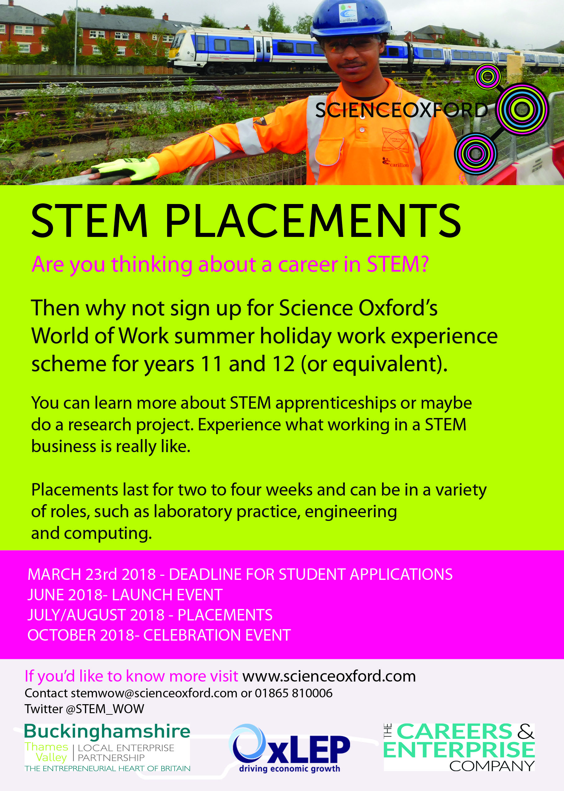
Work experience
At third level – cooperative placement.
Placement of teachers in industry and academic labs.
Work experience in STEM for students.

Slide 27
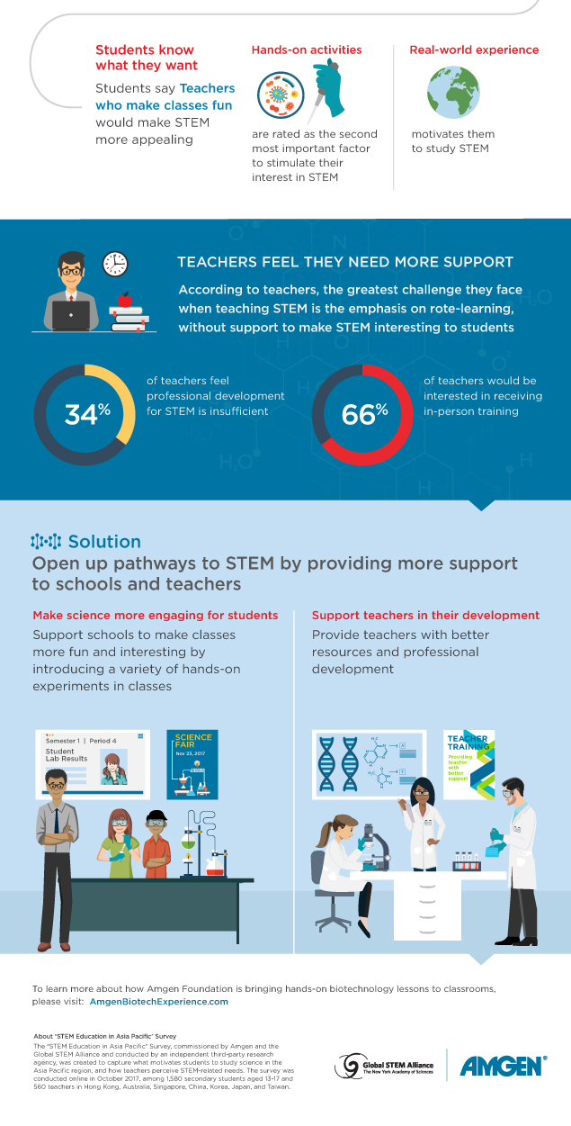
Amgen survey on Asia-Pacific http://www.amgeninspires.com/~/media/amgen/full/www-amgeninspires-com/pdf/regional-infographic.ashx?la=en
Support teachers
Use real-world contexts
Make science more engaging

Slide 28
Industry needs more than STEM skills https://www.weforum.org/agenda/2016/03/21st-century-skills-future-jobs-students/

Slide 29
Developing soft/transferable skills https://www.weforum.org/agenda/2016/03/21st-century-skills-future-jobs-students/

Slide 30
3. Contexts
Curriculum materials and career information must relate to the national context and take into account –
Culture
Religion
Ethnicity
Gender (girls vs boys)
Geography (urban vs rural)
Language(s)

Slide 31
Need for translation and contextualisation
What is appropriate in one context may not be in another one:
Materials or approaches that work in the USA or Europe may not be suitable for the Philippines, Georgia or Israel.
Cultural translation may be needed as much as language translation.
e.g. The role of women or ethnic/religious minorities in society may affect their career orientation.

Slide 32
STEM Alliance
http://www.stemalliance.eu/
The STEM Alliance – inGenious Education and industry, brings together Industries, Ministries of Education and education stakeholders to promote Science, Technology, Engineering and Math education and careers to young European's and address anticipated future skills gaps within the European Union.
The STEM Alliance builds on the success of the inGenious initiative (2011-2014) to increase the links between STEM education and careers, by involving schools throughout Europe.
With the support of major industries and private partners, the STEM Alliance for inGenious Education and Industry activities promote STEM jobs in all industrial sectors and contribute to build a STEM-skilled workforce. The STEM Alliance will join forces to improve and promote existing industry-education STEM initiatives (at national, European and global levels) and contribute to innovation in STEM teaching at all levels of education.

Slide 33
The gender issue
In many countries women are less represented at higher levels in industry and academia.
The leaky STEM pipeline: the proportion of females taking STEM drops off in university and postgraduate work and in the workplace.

Slide 34
Microsoft research into why girls don’t like STEM (March 2017) https://news.microsoft.com/europe/features/dont-european-girls-like-science-technology/
Research by Microsoft has revealed that most girls’ positive views may change within just a few years. The technology company asked 11,500 women between the ages of 11 and 30 in 12 countries across Europe about their attitudes to STEM. The unique insight found that: Most girls become interested in STEM at the age of 11-and-a-half but this starts to wane by the age of 15.
Girls cited a lack of female role models in STEM as a key reason they didn’t follow a career in the sector
Young women are not getting enough practical, hands-on experience with STEM subjects
Just 42% said they would consider a STEM-related career in the future
60% admitted they would feel more confident pursuing a career in STEM fields if they knew men and women were equally employed in those professions

Slide 35
Why do girls lose interest in STEM? New research has some answers — and what we can do about it (March 2018) https://news.microsoft.com/features/why-do-girls-lose-interest-in-stem-new-research-has-some-answers-and-what-we-can-do-about-it/
6,000 U.S. girls and women from ages 10 to 30 who were interviewed .
Providing teachers with more engaging and relatable STEM curriculum, such as 3D and hands-on projects, the kinds of activities that have proven to help retain girls’ interest in STEM over the long haul.
Increasing the number of STEM mentors and role models – including parents – to help build young girls’ confidence that they can succeed in STEM. Girls who are encouraged by their parents are twice as likely to stay in STEM
Creating inclusive classrooms and workplaces that value female opinions. It’s important to celebrate the stories of women who are in STEM right now, today.

Slide 36
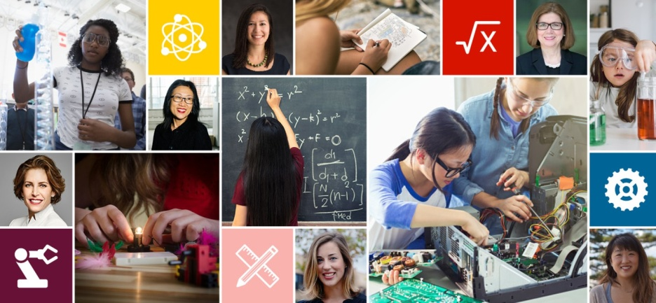
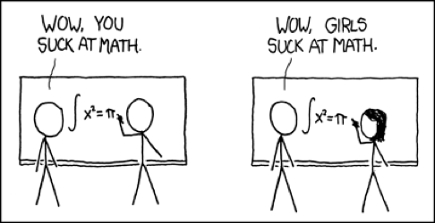
Examples
www.stem2d.org/#intro
www.iwish.ie

Slide 37
Final message
If we want to promote STEM careers in school and at university we must build networks with STEM-based industries and businesses.

Slide 38
Thanks for listening

