Slide 1


www.erasmus-artist.eu

Slide 2
This project has been funded with support from the European Commission.
This publication [communication] reflects the views only of the author,
and the Commission cannot be held responsible for any use which may be
made of the information contained therein.

Slide 3
Action Research:
Theoretical concepts and practical examples II
Franz Rauch

Slide 4

Teacher as reflective practitioner
(Donald Schön 1984)
Knowing in action: Routines
Reflection in action: Reflective conversation with a situation
in class
Reflection on action: Distance from flow of activities in the class
                Action Research
www.erasmus-artist.eu

Slide 5
Reflective rationality
(Feldmann, Altrichter, Posch, Somekh 2018)
Complex practical problems ask for context-specific solutions because they are characterised by ambiguous and partially contradictory aims.
The problem definitions and the strategies necessary to cope with practical situations have to be produced within practical situations by teachers individually or in cooperation with others.
The situational understanding gained by joint reflection on action cannot be directly applied to other situations, but can be made accesible to other practitioners to be tested in their own practice and further developed by them.
www.erasmus-artist.eu

Slide 6
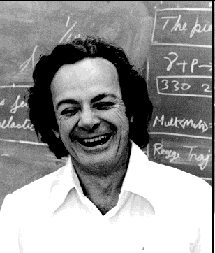
What is research?
(Richard Feynman)
“The first principle is that you must not fool yourself. And you are the easiest person to fool.”
Systematic,
taking all evidences into account, including
those that may contradict your expectations
Self-critical,
being aware of your own biases and prejudices
in relation to the research question
Inter-subjective,
i.e. referring to the knowledge which is already available and publicising new results
www.erasmus-artist.eu

Slide 7
Action research & other modes of enquiry
(Feldman, Altrichter, Posch & Somekh, 2018)
Epistemic interest
BASIC RESEARCH
(generating new knowledge, aiming at a better understanding of fundamental principles)
INTERVENTION RESEARCH
(studying the effects of an intervention into a system in order to gain
knowledge about the system and about the effects of the intervention)
ACTION RESEARCH
(conducting an investigation individually or collectively by gathering and analysing data and reflecting systematically with the aim of improving practice or a complex situation)
ACTION LEARNING
(Experiential learning, learning by doing, tackling real life issues, reflection about learning processes)
Developmental interest
www.erasmus-artist.eu

Slide 8


Action research is committed to a humanistic value system
Civil society & Democracy
Participation & Inclusion
Justice & Equity
Progress & Emancipation
Respect & Pluralism
www.erasmus-artist.eu

Slide 9
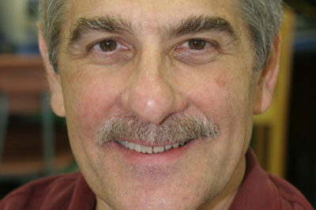
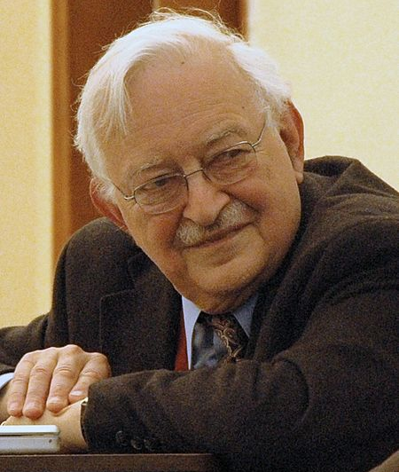
What is empowerment?
“Empowerment is a process by which people, organizations,
and communities gain mastery over their lives.“ (”Having rights
but no resources and no services available is a cruel joke.“)
(Julian Rappaport 1984)
“Empowerment is a social-action process that promotes participation of people, organizations, and communities towards the goals of increased individual and community control, political efficacy, improved quality of community life, and social justice.” (Immanuel Wallerstein 1992)
www.erasmus-artist.eu

Slide 10
Practical & ethical criteria for action research
(Reason & Heron 2008)
① Good action research pursues worthwhile practical purposes
  solutions for authentic problems; sharing relevant knowledge;
  humanistic value system
② Good action research is collaborative / participatory
⇨ involving stakeholders; ‘critical friends’;
⇨ ethical rules (not ‘on’ but ‘with’ people; ownership);
③ Good action research is responsive and developmental
series of research-and-development cycles; feedback;
different perspectives; empowerment
④ Good action research connects theory and praxis
⇨ balancing action and reflection; generating theoretical knowledge and promoting practical improvements.
www.erasmus-artist.eu

Slide 11
Ethics of action research
In order to support the validity of the research
all persons involved are informed about goal, scope and function of the research;
„Owner“ of data is the person who gives the information (Clearing)
www.erasmus-artist.eu

Slide 12
Cycle of action research
Action
Observation → Question
Gathering of data
Interpretation
Planning
Starting point
Distribution
www.erasmus-artist.eu

Slide 13
Steps during the process
Identifying research questions
Reflecting methods
Gathering data
Finding a starting point
Analysing data
Developing stragegies
Implementing in practice
Publishing results
www.erasmusartist.eu

Slide 14
Possible starting points
Pedagogical question
Didactical question
Content question
Wish / Need for change
Personal interest / curiosity
Individual experience
(Locally) Relevant topic
www.erasmus-artist.eu

Slide 15
Identifying research questions
Guiding questions:
I would like to improve by …
I am perplexed by …
I am really curious about …
Something I really think would make a difference is …
Something I really would like to change is …
www.erasmus-artist.eu

Slide 16
What will be the benefit?
If my/our action research will be successful, the benefit will be …
for me:
for my students:
for my colleagues:
for the institutions:
for the ….
www.erasmus-artist.eu

Slide 17
Triangulation
Perspective of third person
Perspective of studends
Perspective of teachers
Or: different methods
www.erasmus-artist.eu

Slide 18

Research diary
  Written thinking and reflection
  Prevent loss of important information
  Analysis of own experiences
Description
Interpretation
www.erasmus-artist.eu

Slide 19
Examples of action research methods
in order to gather data/information
Interviews
Observation
Audio recordings
Questionnaire
Fotos
SWOT-Analysis
Video
www.erasmus-artist.eu

Slide 20
THIRTY YEARS OF EDUCATIONAL REFORM THROUGH ACION RESEARCH
Traces in the Austrian School System
Chapter 2
Franz Rauch, Stefan Zehetmeier & Willibald Erlacher,
IUS – AAU Klagenfurt-Vienna, Austria
www.erasmus-artist.eu

Slide 21
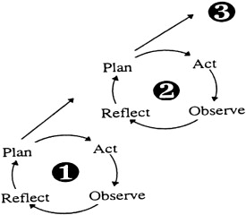





From individual to organizational learning to systems change
① Professional development of teachers based on pedagogical subject knowledge and action research
② Organizational development of schools based on shared visions, programs and evaluation (MA Ed)
③ Intervention into the educational system based on participatory research
1998-99: analyzing the status quo;
2000-04: developing a framework, e.g. aecc,
2004-20: establishing a support system for school innovations
www.erasmus-artist.eu

Slide 22
Trace: Support program
“Innovations Make School Top“ (IMST)
IMST: Innovations Make Schools Top (in Mathematics, Science, Technolgy and Language Teaching)
Start: TIMSS (Third International Mathematics and Science Study)
Webpage: www.imst.ac.at
www.erasmus-artist.eu

Slide 23
Austrian National Project IMST
IMST is a joint initiative of school practice and research to raise the quality of teaching and learning in mathematics, science and technology
Core activities are action research projects about innovations in instructional and school development
Core measures are the establishment of
- Regional networks (in all of the nine Austrian provinces)
- National and regional centres for subject instruction
- Thematic programmes
- Gender network
www.erasmus-artist.eu

Slide 24
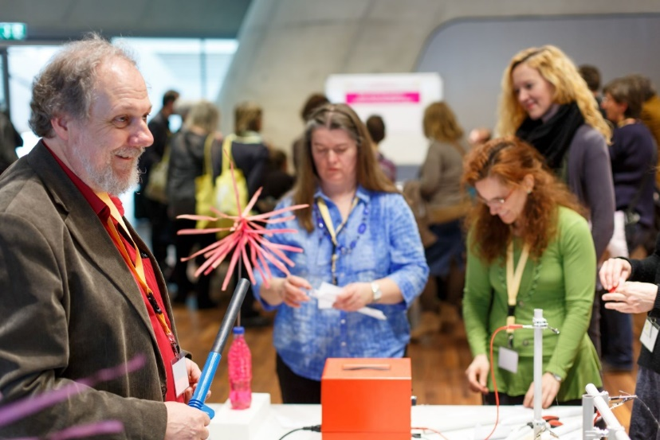
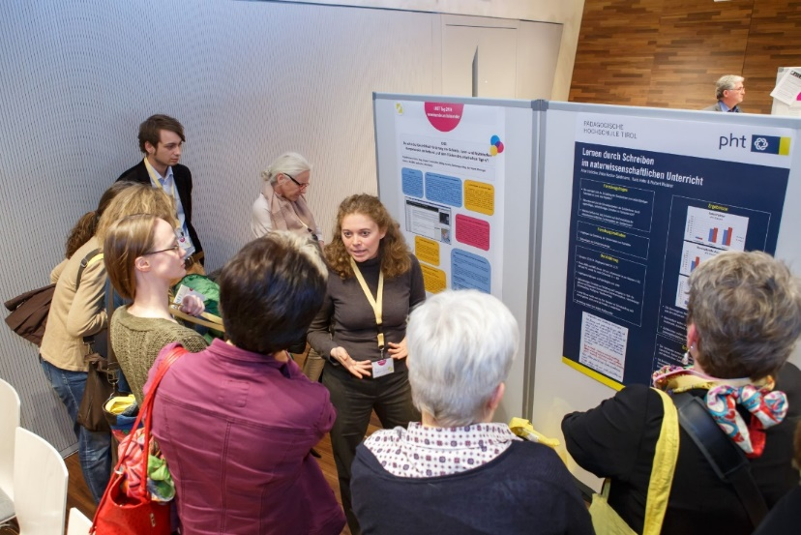
IMST: Basic Ideas
Learning of students is central
Reflection (based on action research) and networking as main intervention strategies
Systemic thinking (individual, team, school, whole school system, society)
Gender sensitivity and gender mainstreaming
Building upon existing ressources and strenghts
www.erasmus-artist.eu

Slide 25
Lessons learned
Gange projects need …
…visible challenges and visible success
… individual and organizational efforts
… flexible plans and the use of windows of
opportunity
… active insistence and resilience as well as
patience
… accepting and allocating reponsibility
www.erasmus-artist.eu

