Slide 1
www.erasmus-artist.eu

Slide 2
This project has been funded with support from the European Commission.
This publication [communication] reflects the views only of the author,
and the Commission cannot be held responsible for any use which may be
made of the information contained therein.

Slide 3
Action Research: Theoretical concepts and practical examples I
Ingo Eilks

Slide 4
Overview
What is Action Research?
What makes Action Research different
Types of Action Research
How to implement Action Research? – The case of Ivano from Switzerland
Where to find support for my Action Research
www.erasmus-artist.eu

Slide 5
What is Action Research?

Slide 6
Action Research
Action Research is the study of a social situation carried out by those involved in that situation in order to improve both their practice and the quality of their understanding. (Winter & Munn-Giddings 2001)
The research interest is in the service of practice interests. (Posch 2003)
www.erasmus-artist.eu

Slide 7
Features of Action Research
AR is carried out by people (e.g. teachers) directly concerned with the social situation that is being researched (e.g. teaching and learning of science)
AR starts from practical questions arising from everyday educational work
AR offers a repertoire of simple methods and strategies for researching and developing practice e.g. diaries, observation profiles, interviews, simple questionnaires (sensible ratio of costs to results)
AR is characterized by inserting individual findings into a professional discussion and by making knowledge of teachers open to the public
www.erasmus-artist.eu

Slide 8
What Action Research makes different

Slide 9
What differs Action Research from traditional research
Topic | Formal research | Action research
Training needed by researcher | Extensive | On own or with consultation
Goals of research | Knowledge that is generalizable | Knowledge to apply to the local situation
Method of identifying the problem to be studied | Review of previous research | Problems of goals currently faced
Procedure of literature review | Extensive using primary sources | More cursory, using secondary sources
Sampling approach | Random or representative sampling | Students or clients with whom they work
Research design | Rigorous control, long time frame | Looser procedures, change during study; quick time frame; control through triangulation
Measurement procedures | Evaluate and pretest measures | Convenient measures or standardized tests
Data analysis | Statistical tests, qualitative techniques | Focus on practical, not statistical significance, present raw data
Application of results | Emphasis on theoretical significance | Emphasis on practical significance
www.erasmus-artist.eu

Slide 10
The underlying research paradigms
(post-)Positivism Deterministic Reductionistic Empirical observation and measurement Aim: Theory verification | Constructivism Understanding by interpretation Multiple meanings Social and historical (re)-construction Aim: Theory generation
Pragmatism Consequences of action Problem-centred Pluralistic Real-world oriented Aim: Change | Criticality (Advocacy/Participatory) Political Empowerment Issue-oriented Collaborative Aim: Emancipation
www.erasmus-artist.eu

Slide 11
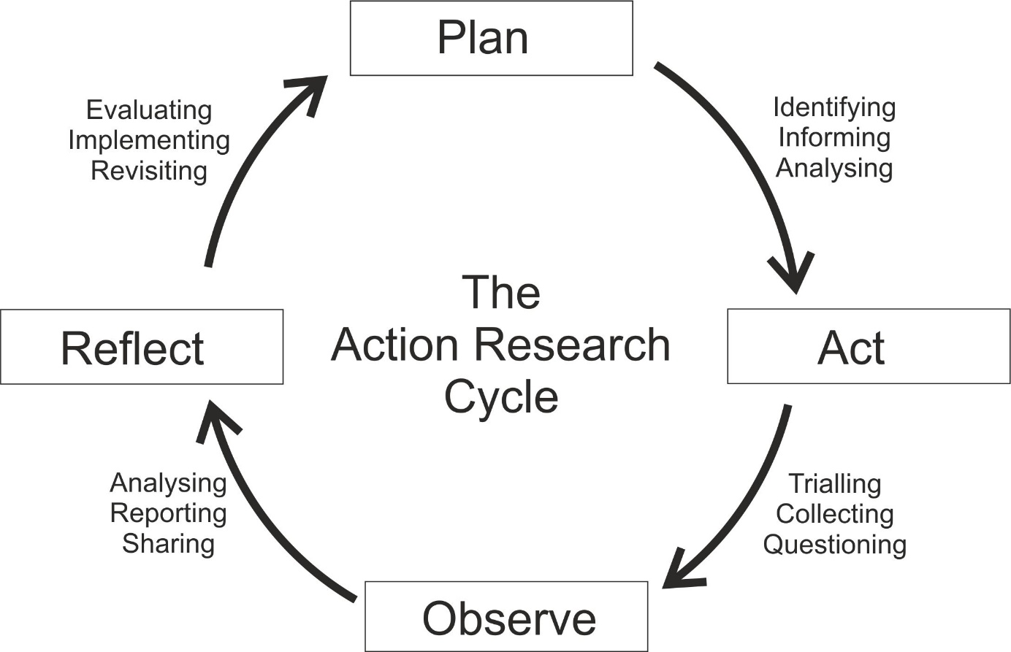
The Action Research cycle
www.erasmus-artist.eu

Slide 12
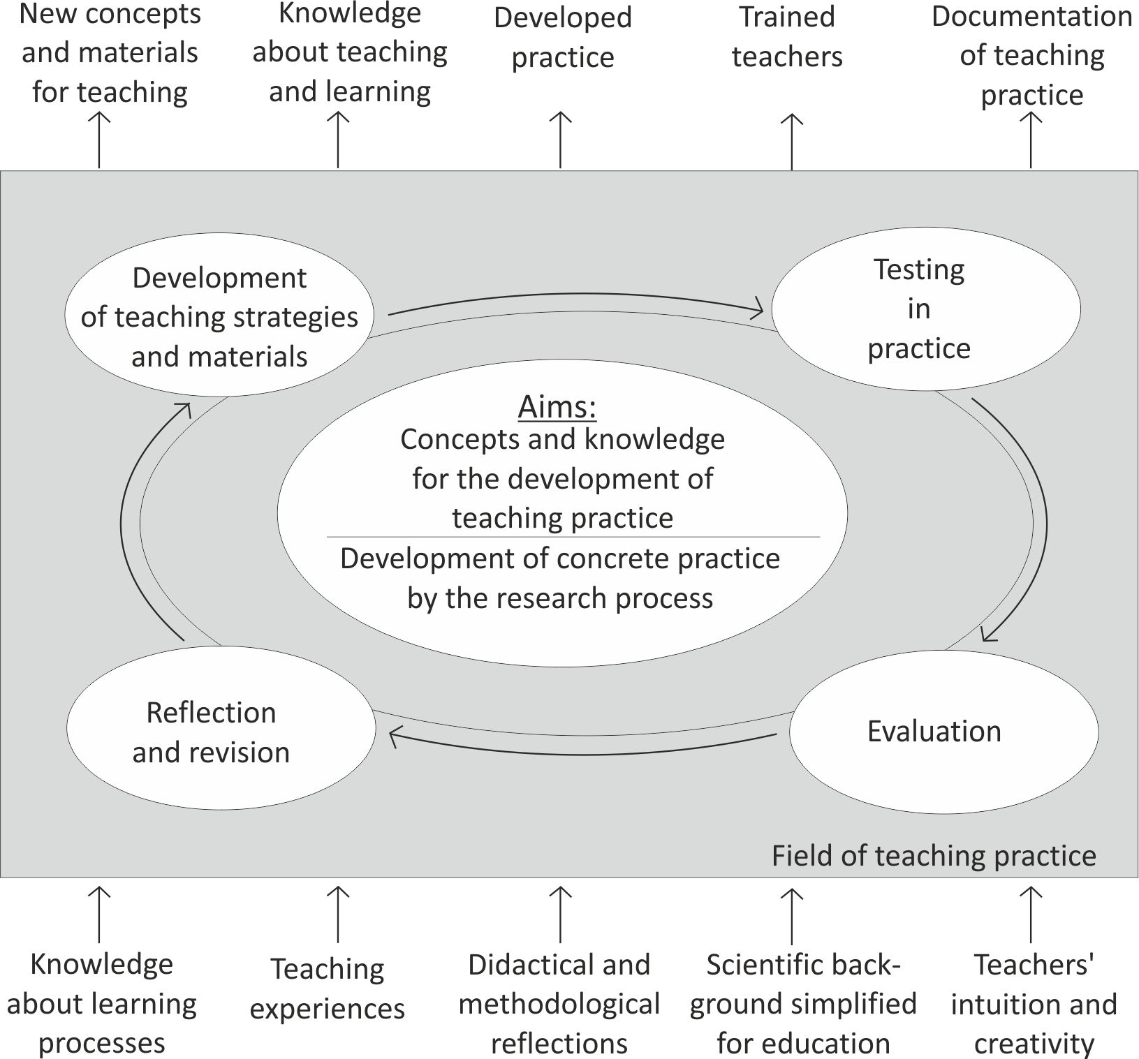
One model for AR in science education
www.erasmus-artist.eu

Slide 13
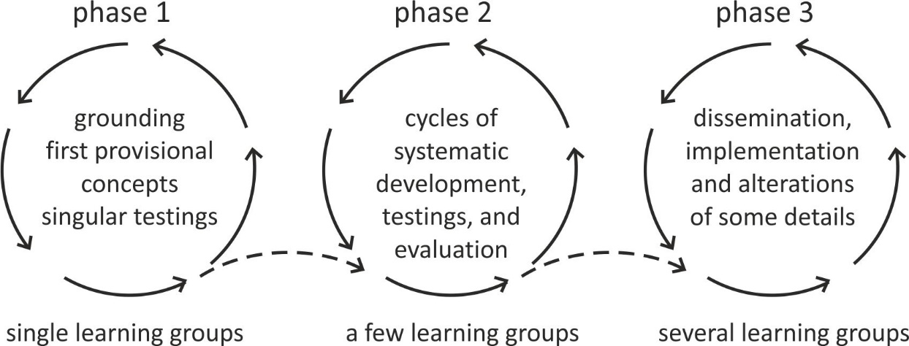
The idea of upscaling
www.erasmus-artist.eu

Slide 14
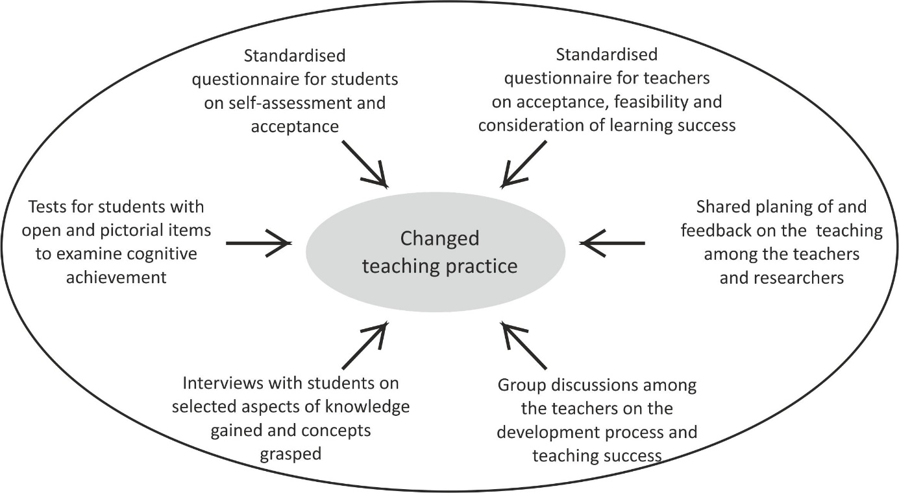
Constructing meaning by triangulation
www.erasmus-artist.eu

Slide 15
Types of Action Research: Three countries, three cases, three approaches

Slide 16
Types of Action Research
Technical action research |  | Practical (or participatory/interactive) action research |  | Emancipatory (or teacher-centered) action research
“The underlying goal of the researcher in this approach is to test a particular intervention based on a pre-specified theoretical framework, the nature of the collaboration between the researcher and the practitioner is technical and facilitatory. The researcher identifies the problem and a specific intervention, then the practitioner is involved and they agree to facilitate with the implementation of the intervention.” |  | “In this type of action research project the researcher and practitioner come together to identify potential problems, their causes and potential interventions. The problem is defined after dialogue with the researcher and the practitioner and a mutual understanding is reached.” |  | “Emancipatory action research promotes emancipatory praxis in the participating practitioner, that is, it promotes a critical consciousness which exhibits itself in a political as well as practical action to change. […] This mode of emancipatory action research does not begin with the theory and ends with practice, but is informed by theory and often it is confrontation with the theory that provides the initiative to undertake the practice. […] The dynamic relationship between theory and practice in emancipatory action research entails the expansion of both theory and practice during the project.”
www.erasmus-artist.eu

Slide 17
Enabling teachers for individual AR studies (Israel)
22 experienced high school science teachers.
Teachers attend a series of workshops about the methodology and the tools to be applied for data collection and evaluation within AR.
1) Action Research principles
2) The qualitative research approach
3) Methodology (rationale for choosing a subject for research, defining a good research question, research tools and data collection, and data analysis
4) Reflection at each of the stages, and
5) Presentation of reports.
Workshops interplay with phases of working and doing AR in the regular school environment.
(e.g. Mamlok–Naaman, Navon, Carmeli, & Hofstein, 2003; Dass, Hofstein, Mamlok-Naaman, Dawkins & Pennick, 2008 ; Mamlok-Naaman & Eilks, 2011)
www.erasmus-artist.eu

Slide 18
Enabling teachers for individual AR studies (Israel)
Teachers conducted individual AR studies, on
Students’ understanding of specific topics
Behavior or motivation
Own teaching and how it functions in class
Teachers became aware of the importance of reflecting upon their work by AR and the methods they learned.
Some continued case studies about their students.
Almost all the teachers felt to have become a member of a team during the workshop meetings, and that they continued to exchange ideas within the group.
… but dissemination of the results is still a problem.
(e.g. Mamlok–Naaman, Navon, Carmeli, & Hofstein, 2003; Dass, Hofstein, Mamlok-Naaman, Dawkins & Pennick, 2008 ; Mamlok-Naaman & Eilks, 2011)
www.erasmus-artist.eu

Slide 19
Creating a collaborative AR communities (UK)
6 teachers from 6 different schools; later expansion to a total of 13 teachers from 12 schools.
Teachers develop and evaluate new approaches in the teaching and learning concerning models and modelling in science.
Each teacher was free to nominate the context in which and the purpose for which the AR will take place.
External expertise was available on request.
(e.g. Newberry & Gilbert, 2004; Newberry, Gilbert & Hardcastle, 2005)
www.erasmus-artist.eu

Slide 20
Creating a collaborative AR communities (UK)
Individual projects started on a small scale, but gradually expanded in scope and the number of colleagues involved; not only within schools but also between schools.
Professional development by learning about different approaches and exchange with colleagues and accompanying experts.
Joint development of better teaching approaches.
Credit and acknowledgement for individual engagement. Insights in personal career ambitions.
Teachers felt lack in time for careful evaluation of the data and for documentation and dissemination.
(e.g. Newberry & Gilbert, 2004; Newberry, Gilbert & Hardcastle, 2005)
www.erasmus-artist.eu

Slide 21
Networking teachers and researchers (Germany)
Establishing AR group in August 1999
The research team in the beginning:
1 researcher, plus PhD- and MEd-students
8 teachers from middle and grammar schools
Meetings every 4 weeks for one afternoon (3-4 hrs)
Growth of the group up to 15 teachers within 3 years
Continuous work for about 19 years now
Topics of interest are both introduced, by teachers needs or research findings.
(e.g. Eilks & Ralle, 2002; Eilks, 2003; Eilks & Markic, 2011; Mamlok-Naaman & Eilks, 2011)
www.erasmus-artist.eu

Slide 22
How to improve one‘s own practice – the case of Ivano

Slide 23
Action Research as a science teacher‘s project
Context:
Chemistry teaching at a vocational school in southern Switzerland.
Research interest:
Changing teacher centred pedagogies with students are passive recipients of information
Foster implementation of cooperative learning and use of modern ICT
Action:
Implementaton of student active learning with modern ICT on the topic of chemical bonding
www.erasmus-artist.eu

Slide 24
Action Research as a science teacher‘s project
Problem:
No available teaching concepts or media for Swiss vocational schools.
No available research on cooperative learning in Swiss vocational chemistry education.
No corresponding experts in the country, neither on classroom innovation in chemisry, no available professional development.
No available network of chemistry teachers to work with.
No support from within the school because of a high diversity on study programs.
www.erasmus-artist.eu

Slide 25
Action Research as a science teacher‘s project
Implementing action:
Contact to the University of Bremen as having expertise both in classroom innovation, as well as in action research.
Integration into a network of chemistry teachers in Western Germany (working by action research for 20 years) via synchronous and asynchronous digital communication (Skype meetings, Emails, Dropbox, …).
Development and testing of a new teaching concept on chemical bonding based on the idea of the concept „Tour de Chemie“, developed earlier in the German action research network.
Collection of feedback, 3 cycles in 3 consecutive school years.
www.erasmus-artist.eu

Slide 26
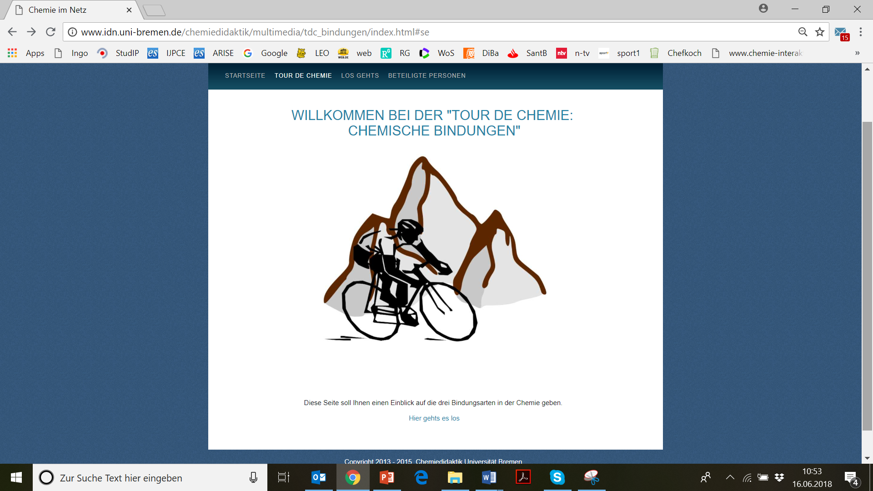
Action Research as a science teacher‘s project
www.erasmus-artist.eu

Slide 27
Action Research as a science teacher‘s project
Results:
Implementation of a new teaching concept on chemical bonding based on the idea of the concept „Tour de Chemie“.
Stepwise development of the right degree of autonomy in learning based on student feedback.
Learning by the teacher about students‘ perceptions of altered and more open teaching apporaches.
General results about the differences of students‘ perceptions of autonomous and cooperative learning between general secondary eduation and vocational school education.
www.erasmus-artist.eu

Slide 28
Action Research as a science teacher‘s project
Results:
Laudonia, I., & Eilks, I. (2015). Chemieunterricht und Chemiedidaktik an berufsbildenden Schulen – Status Quo und Perspektiven. Chemie Konkret, 22(3), 119-124.
Laudonia, I., Mamlok-Naaman, R., Abels, S., & Eilks, I. (2018). Action research in science education - An analytical review of the literature. Educational Action Research advance article.
Laudonia, I., & Eilks, I. (2016). Lehrerzentrierte vs. Partizipative Aktionsforschung – Praxisorientierte Forschung und Unterrichtsentwicklung in der beruflichen Bildung. Transfer Forschung Schule, 2, 125-132.
Laudonia, I., & Eilks, I. (2018). Teacher-centred action research in a remote participatory environment – A reflection on a case of chemistry curriculum innovation in a Swiss vocational school. In J. Calder and J. Foletta (eds.), Participatory Action Research (PAR): Principles, approaches and applications (pp. 215-231). Hauppauge: Nova.
Laudonia, I., & Eilks, I. (2018). Reflections on a three years long teacher-centred/participatory action research experience on teaching chemical bonding in a Swiss vocational school. Education Sciences, 8(3), 141-.
Laudonia, I., & Eilks, I. (invited). Chemische Bindungen – Ein Innovationsprojekt an einer Schweizer Berufsschule. Naturwissenschaften im Unterricht.
www.erasmus-artist.eu

