Slide 1
www.erasmus-artist.eu

Slide 2
This project has been funded with support from the European Commission.
This publication [communication] reflects the views only of the authors,
and the Commission cannot be held responsible for any use which may be
made of the information contained therein.

Slide 3
The ARTIST PPT Toolkit
Ingo Eilks and the ARTIST consortium
www.erasmus-artist.eu

Slide 4
About
The toolkit consists of figures from the ARTIST Guidebook for free use in presentations about action research in teacher education workshops.
The toolkit was prepared by the ARTIST – Action Research to Innovate Science Teaching Project (Editors Franz Rauch, Marika Kapanadze, Nadja Frerichs and Ingo Eilks)
This guide is part of the ARTIST – Action Research to Innovate Science Teaching project. The project was co-funded by the European Union under the program ERASMUS+ - Capacity Building in Higher Education (CBHE) from 2016-2019 under grant agreement number 573533-EPP-1-2016-1-DE-EPPKA2-CBHE-JP.
This guide is published under a Creative Commons Attribution-NonCommercial-ShareAlike (BY-NC-SA) license
www.erasmus-artist.eu

Slide 5
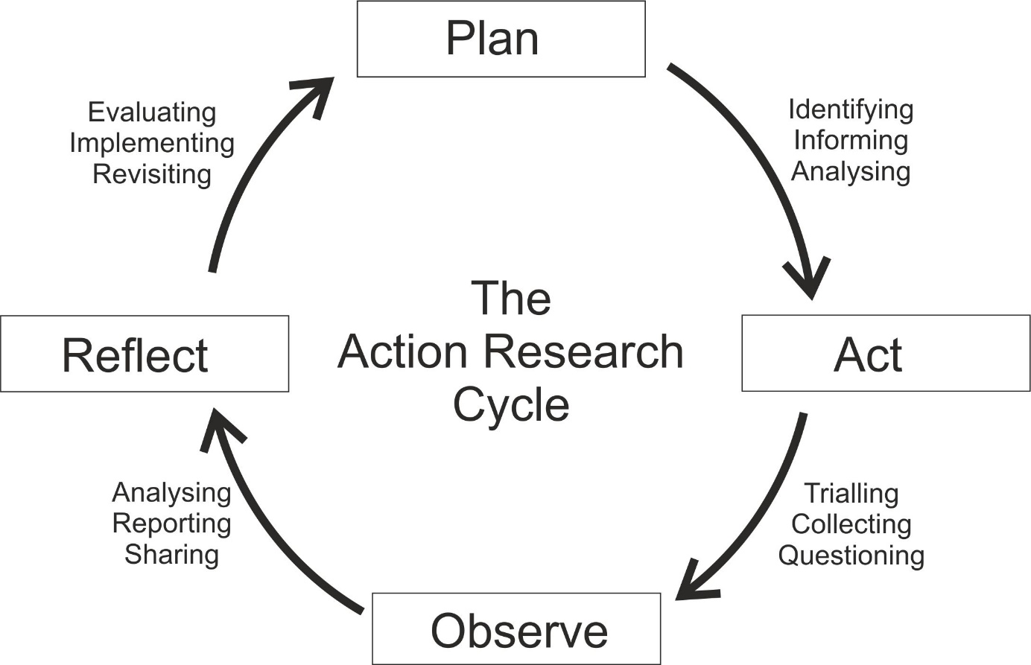
The Action Research cycle
www.erasmus-artist.eu

Slide 6
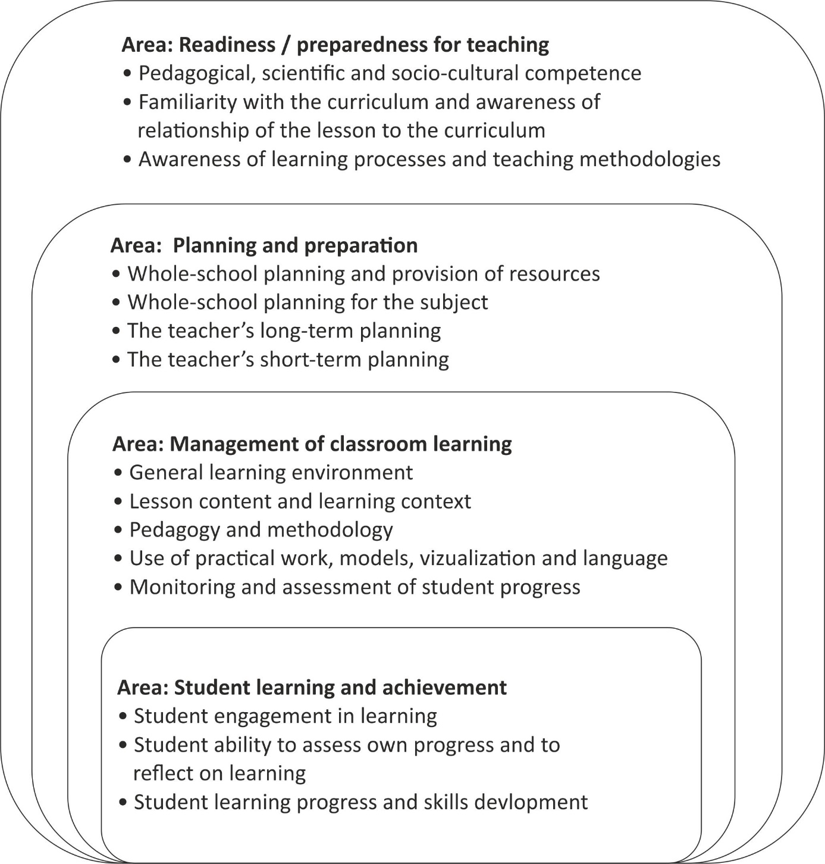
A model to reflect potential fields for action research to innovate science education
www.erasmus-artist.eu

Slide 7
Classroom research, teacher research, and action research in science education
 | Classroom research | Teacher research | Action research
Takes place in authentic science teaching practice where students and teachers come together for learning science | X | X | X
Is operated either by a teacher or under strong involvement of the corresponding science teacher |  | X | X
Intends changes and applies a clear and cyclical strategy of change, data collection, evaluation and reflection |  |  | X
www.erasmus-artist.eu

Slide 8
Types of Action Research
Technical action research |  | Practical (or participatory/interactive) action research |  | Emancipatory (or teacher-centered) action research
“The underlying goal of the researcher in this approach is to test a particular intervention based on a pre-specified theoretical framework, the nature of the collaboration between the researcher and the practitioner is technical and facilitatory. The researcher identifies the problem and a specific intervention, then the practitioner is involved and they agree to facilitate with the implementation of the intervention.” |  | “In this type of action research project the researcher and practitioner come together to identify potential problems, their causes and potential interventions. The problem is defined after dialogue with the researcher and the practitioner and a mutual understanding is reached.” |  | “Emancipatory action research promotes emancipatory praxis in the participating practitioner, that is, it promotes a critical consciousness which exhibits itself in a political as well as practical action to change. […] This mode of emancipatory action research does not begin with the theory and ends with practice, but is informed by theory and often it is confrontation with the theory that provides the initiative to undertake the practice. […] The dynamic relationship between theory and practice in emancipatory action research entails the expansion of both theory and practice during the project.”
www.erasmus-artist.eu

Slide 9
Modes of Action Research in terms of interest
"Technical action research serves the interests of exercising greater control over human behaviour to produce the desired outcomes;
practical action research serves the interests of practical wisdom in discerning the right course of action in particular circumstances;
critical [emancipatory] action research serves the interests of emancipating people from oppression."
Elliott, J. (2005). Becoming critical: the failure to connect. Educational Action Research, 13, 359-374.
www.erasmus-artist.eu

Slide 10
Modes of Action Research in terms of power
“The differences in the relationship between the participants and the source and scope of the guiding ‘idea’ can be traced to the question of power.
In technical action research it is the ‘idea’ which is the source of power for action and since the ‘idea’ often resides with the facilitator, it is the facilitator who controls power in the project.
In practical action research the power is shared between groups of equal participants, but the emphasis is upon individual power of action.
Power in emancipatory action research resides wholly within the group, not with the facilitator and not with individuals within the group.
It is often the change in power relationships within a group that causes a shift from one mode to another.”
Grundy, S. (1982). Three modes of action research. Curriculum Perspectives, 2(3), 23–34.
www.erasmus-artist.eu

Slide 11
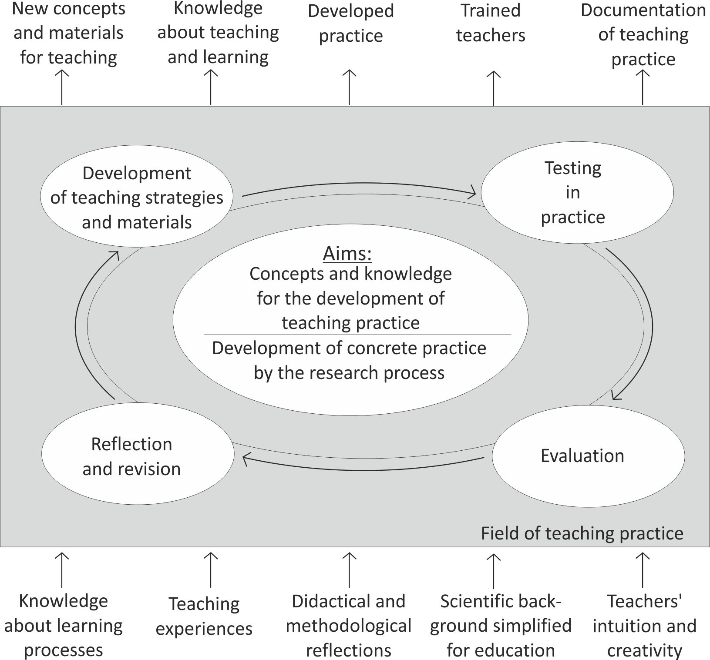
One model for AR in science education
www.erasmus-artist.eu

Slide 12
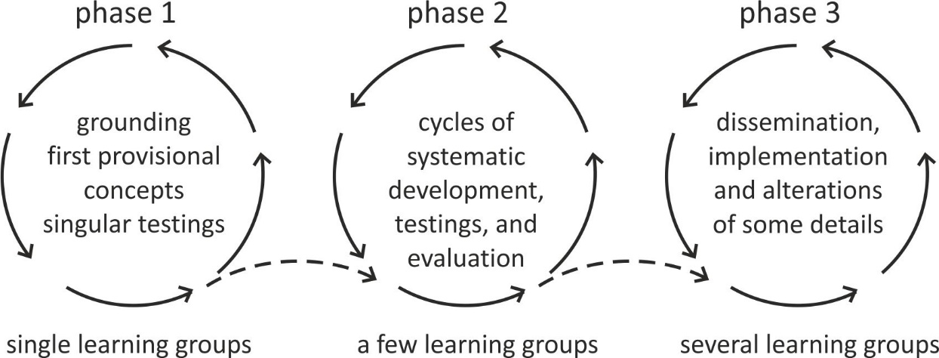
The idea of upscaling
www.erasmus-artist.eu

Slide 13
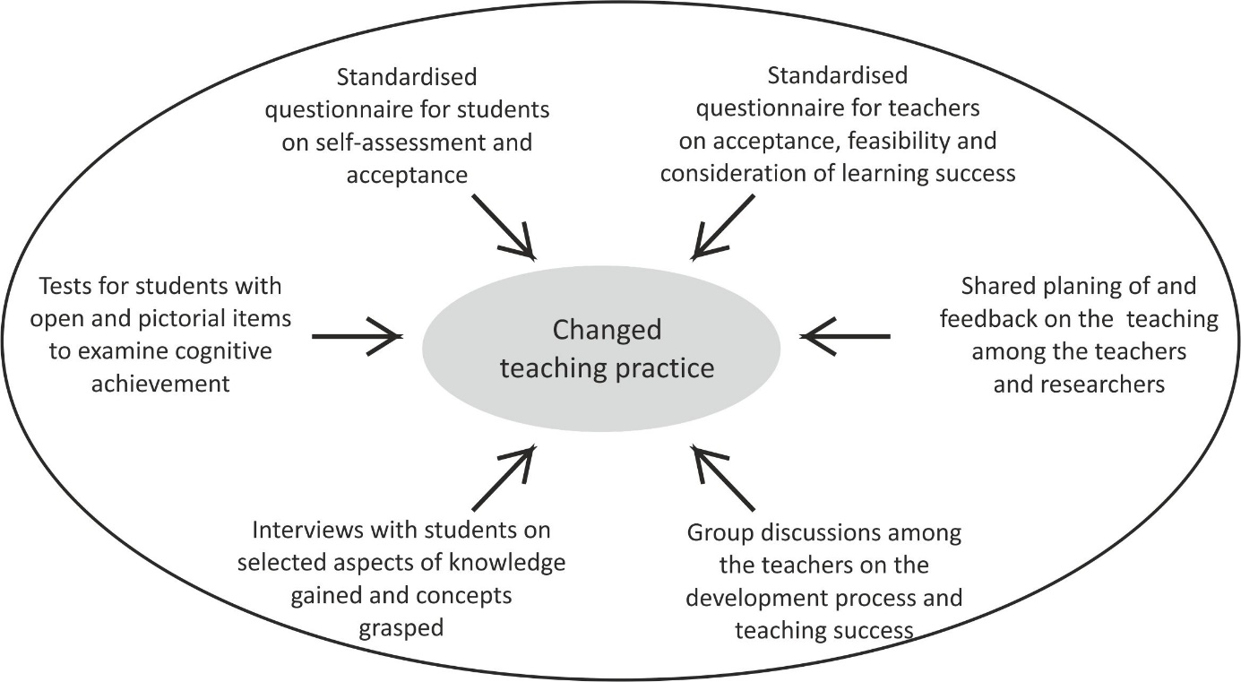
Constructing meaning by triangulation
www.erasmus-artist.eu

Slide 14
What differs Action Research from traditional research
Topic | Formal research | Action research
Training needed by researcher | Extensive | On own or with consultation
Goals of research | Knowledge that is generalizable | Knowledge to apply to the local situation
Method of identifying the problem to be studied | Review of previous research | Problems of goals currently faced
Procedure of literature review | Extensive using primary sources | More cursory, using secondary sources
Sampling approach | Random or representative sampling | Students or clients with whom they work
Research design | Rigorous control, long time frame | Looser procedures, change during study; quick time frame; control through triangulation
Measurement procedures | Evaluate and pretest measures | Convenient measures or standardized tests
Data analysis | Statistical tests, qualitative techniques | Focus on practical, not statistical significance, present raw data
Application of results | Emphasis on theoretical significance | Emphasis on practical significance
www.erasmus-artist.eu

Slide 15
The research paradigms in science education
(post-)Positivism Deterministic Reductionistic Empirical observation and measurement Aim: Theory verification | Constructivism Understanding by interpretation Multiple meanings Social and historical (re)-construction Aim: Theory generation
Pragmatism Consequences of action Problem-centred Pluralistic Real-world oriented Aim: Change | Criticality (Advocacy/Participatory) Political Empowerment Issue-oriented Collaborative Aim: Emancipation
www.erasmus-artist.eu

Slide 16
Potential roles of teacher researchers and external researchers in action research
Teacher researcher | External researcher
Initiation of action research motivated by experience Analysis of the literature in comparison to classroom experience Structuring new strategies and concepts Application of new strategies and concepts Data collection Evaluation of data Joint reflection and negotiating of further change | Initiation of action research motivated by prior research Co-ordination and support of the teacher research Providing relevant literature and information access Providing access to already existing strategies and concepts Support in keeping ethical measures and standards of research data handling Methodological training and support in evaluation of data Joint reflection and negotiating of further change Support in dissemination and publication of the action research findings
www.erasmus-artist.eu

